Slide 1
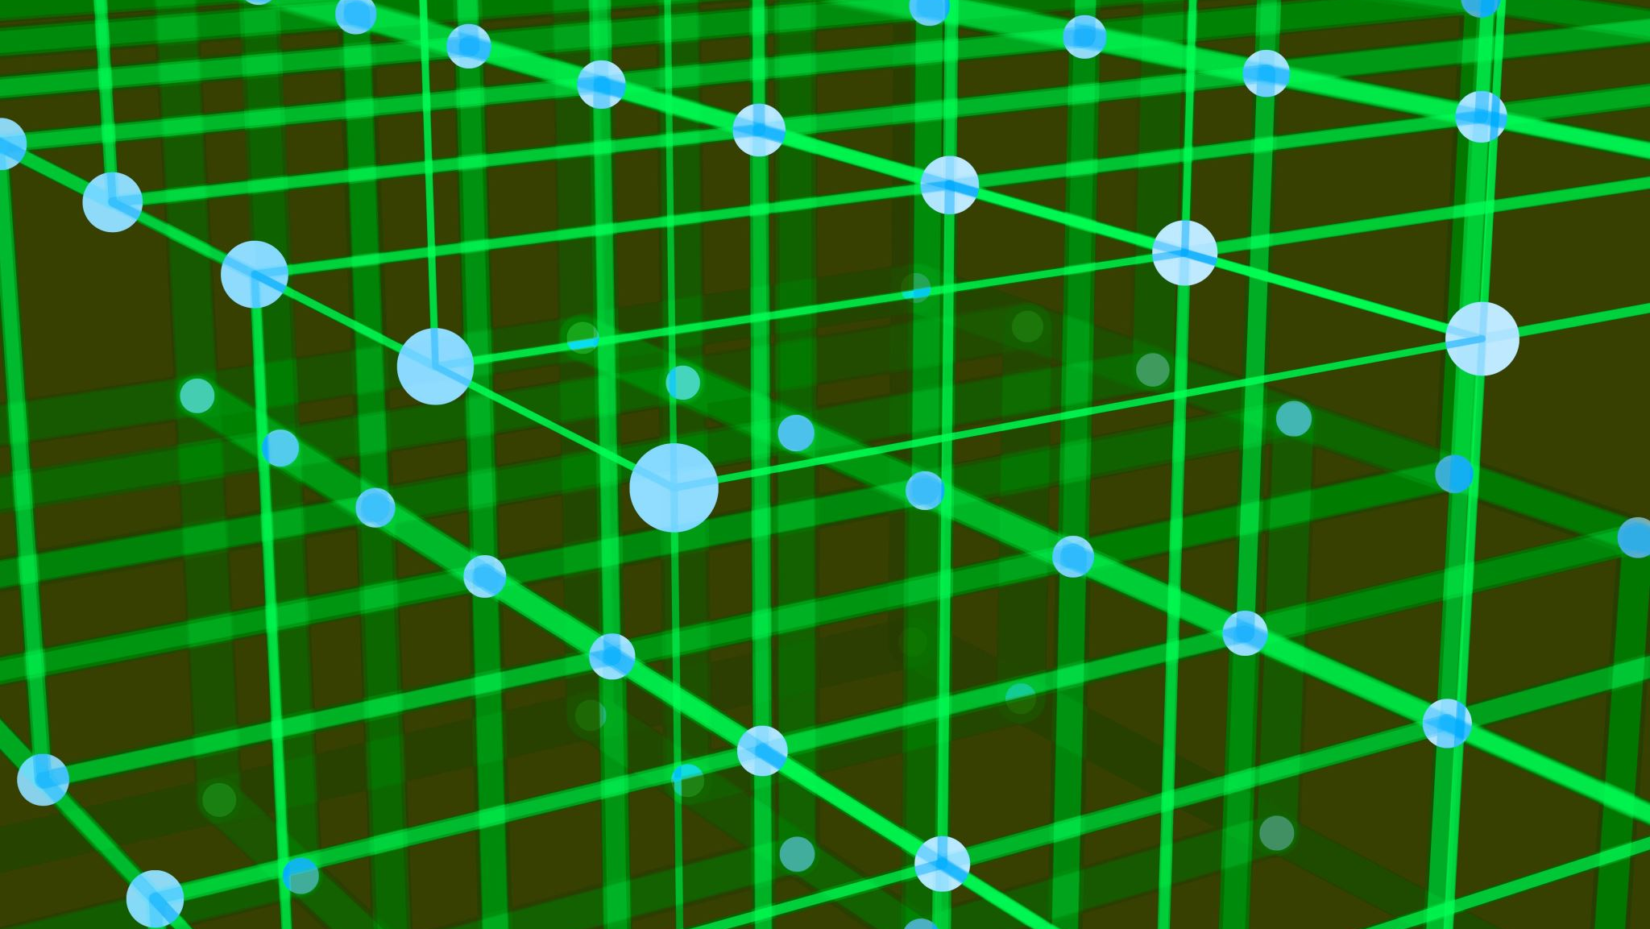
Algorithmic policing
Michel Fournier-Simard
Dawson College
Winter 2022

Slide 2
Algorithmic policing
What is AI ? What is Policing ? What is Algorithmic Policing?
Algorithmic Policing in Canada
Policy Solutions

Slide 3
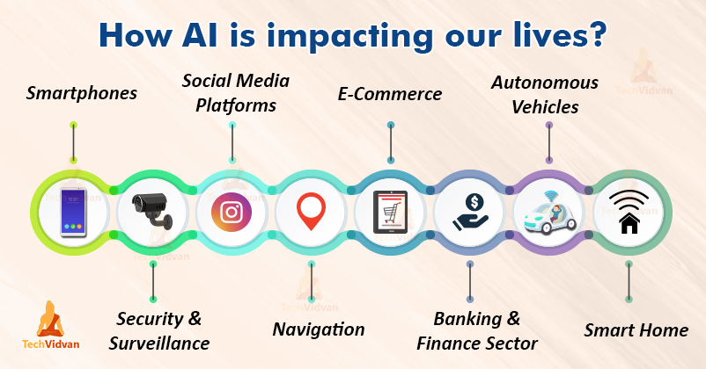

Slide 4
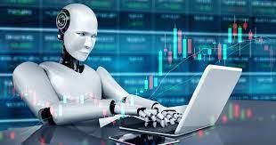
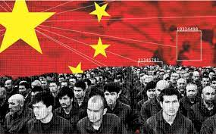
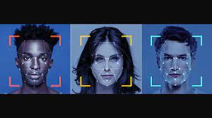
What do you know about ai ?
Have algorithms impacted you in the last 24h?
The good
The not so good ?
AI & Power

Slide 5
What is ai
“Artificial” = the use of computers, the automatization
“Intelligence” = most Human behaviors: learning, perception, reasoning, using language, counting, predicting, problem solving.
AI: Using computers to mimic human decision-making & problem solving capacities
Source: B.J. Copeland, Britannica
Algorithms: a series of instructions given to a computer to transform data into useful information / decisions
Notes:
Ask the students examples of AI influences on their lives: did they use Instagram today? Netflix? Took a bus to school?

Slide 6
What is policing
The ”armed arm of the State”
Weber’s definition of the State
The capacity to use force (Brodeur)
Police discretion and the centrality of decision making (Monjardet)
How does AI influence this capacity - this power ?
Also, what is force?

Slide 7
Algorithmic Policing
The use of algorithms and AI to enhance – and potentially transform – police decision-making practices
Use mass data to inform daily operations
Potential benefits: + safety + efficient + proactive - bias + accountability
Potential downfal + bias - accountability - mass surveillance - privacy - civil rights

Slide 8
everyday AI in Canadian Policing
Ai is used everyday for clerical effectiveness
Automatic transcription
Scheduling
= more officers in the streets, preventing crime and doing community policing
But what about other, more controversial Police uses of AI? What are the big issues here?

Slide 9
pRIVACY
Traditional limits to police power
Resources limitations (time, manpower, cost)
Public oversight of the police
AI allows gathering, processing, and analyzing an amount of data that would have been unthinkable just a few years ago, including vast amount of private citizen information
Dragnet surveillance: widening the police database inclusion “trigger mechanism”
Inexpensive, and behind screens

Slide 10
Google Quick, draw! Exercise

Slide 11
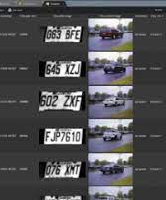
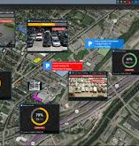
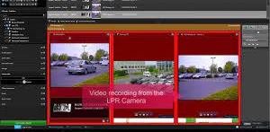
Object Recognition Software (1)
Automatic Licence Plate Readers
+10 years of AI in Canadian policing
SPVM: among the firsts in Canada
The industry leader: Genetec (Montreal)
More efficient
Bias: no more “random” road stops?
Privacy
You have a car and live in Quebec? The SPVM likely has data on where your car was in the last five years.
Images taken from Genetec Autovu promotional material

Slide 12
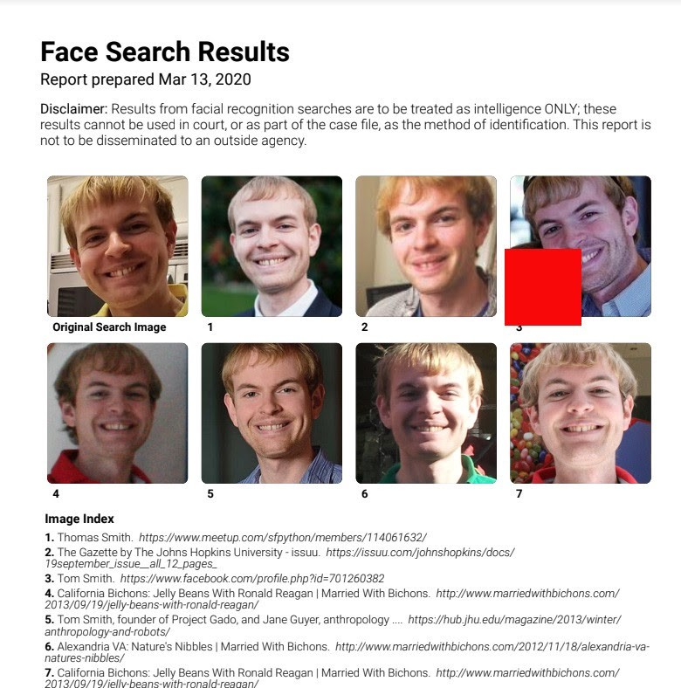
Object Recognition Software (2)
Winter 2020 Clearview AI scandal
48 Clients including the RCMP, TPS, VPD, etc.
Social Media databases
AI in policing studently becomes a scary prospect for the general public
Facial Recognition in Canadian Policing
Since 2014 in Calgary, Toronto, etc… Despite over 4% error rates!
Since 2020 in Quebec, Sûreté du Québec
Mugshot database, now 0.08% error rates
T Smith, OneZero.medium

Slide 13
bias
Algorithms are the product of the data they are fed (which might be biased), and the biases of their creators (intentional or not).
AI makes mistakes, but not all have the same consequences
A bad Netflix recommendation
Biased credit ratings
Bail hearing & MachineBias Reports
Blind reverence to AI as a neutral fix-all solution to social problems risks reproducing existing biases with the imprimatur of impartiality

Slide 14
Predictive Policing
The use of historical data to forecast where crimes are likely to occur or by whom to deter them before they happen
Historical data, especially in a policing context, might be particularly biased
Can lead to the continued overpolicing of marginal communities with the apparance of algorithmic impartiality

Slide 15
Person-Based PP
The Chicago PD Strategic Subject list
LAPD PredPol Fiasco
Person-Based Applications ’’for good’’ in Saskatchewan
Missing children
Privacy implications
Collaboration with Universities to legitimize surveillance

Slide 16
Vancouver police –2019-202…
Placed-Based Predictive Policing that impacts daily policing practices
Deep learning / Machine learning. By Definition, this means even the VPD does not know what is taken into account to make predictions
Adoption process with limited overseight
Took preliminary (unconvincing) data as proof of concept
Dealing with potential biases
Excluded the DTES
Only includes crime datapoints reported by citizens, but what about their biases? Re: the central park birdwatcher incident

Slide 17
Policy Issues
Traditional accountability mechanisms (police boards, resource limitation) is not enough
Declarations and Ethical AI are strategies used by actors in the industry to avoid regulation...

Slide 18
Policy Solutions
Governmental action
Give money now, regulate later
2019 TBSC Directives on Automated Decision-Making (but Chinook)
Privacy Commissioners
Ontario Privacy Commissioner Assessment on add-on software (2017)
Local politicians
Summer 2020 – Commission de la Sécurité Publique de Montréal & ALPRs
Toronto June 2020 City Council, direct impacts on BWC adoption in July 2020
Halifax Police Board: keeping the police on their toes

Slide 19
To conclude… Shared policy concerns
Algorithmic policing is not developing in a vacuum
Healthcare --» privacy of data
Credit score biased decision-making --» predictive policing
Social media regulation & police dragnet surveillance practice
But your doctor, banker, or Instagram Influencer cannot arrest you

Slide 20
To conclude (bis)… Particularities of policing
Algorithmic Policing cannot be treated as just another AI Policy field
Policing as a unique government responsibility. One which enables an institution to surveil and use coercive force to restrain civil liberties
AI can completely transform how our societies are policed, the invasiveness of which cannot be understated. This is fundamentally a democratic question. At its core: the power balance between citizens and their police.

Slide 21
Extra slides

Slide 22
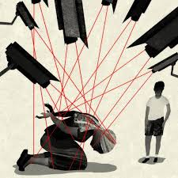
Chinese Police State & the Uyghurs

Slide 23
Algorithmic Policing in a democratic context
What are the big issues to consider ?
What forms of algorithmic policing are in use in Canada?
What are governments doing ?

