Slide 1
Artificial Intelligence & Liberal democracies – Promises and perils

Slide 2
IS CLASS 2
(CLASS 1 FOCUSED ON PRESENTING THE OUTLINE FOR THE COURSE, EVALUATIONS, ETC.)

Slide 3
Liberal Democracy
Political System
Liberalism
  Limited Government
  Individual Freedoms
  Rule of Law
Democracy
  Free & Fair Elections
“Open” Society
  Human rights
  Civil liberties (free press, free speech, freedom of association)
Separation of Power
Can take different constitutional form: Republic, Monarchy
… & different regimes: Presidential, semi-presidential, parliamentary

Slide 4
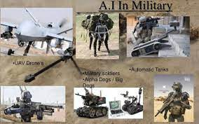


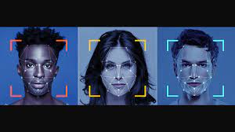

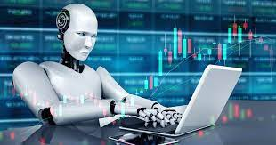
What do you know about ai ?
Have algorithms impacted you in the last 24h?
The good
The not so good ?
AI & Power

Slide 5
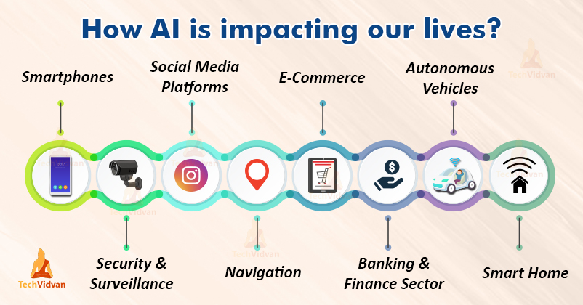

Slide 6
What is ai
“Artificial” = the use of computers, the automatization
“Intelligence” = most Human behaviors: learning, perception, reasoning, using language, counting, predicting, problem solving.
Using computers to mimic human decision-making & problem solving capacities
Source: B.J. Copeland, Britannica
Algorithms: a series of instructions given to a computer to transform data into useful information / decisions
Notes:
Ask the students examples of AI influences on their lives: did they use Instagram today? Netflix? Took a bus to school?

Slide 7
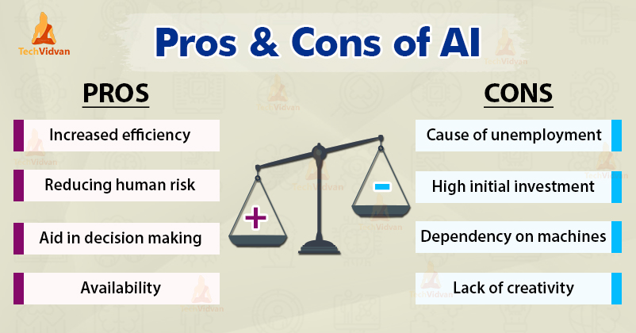

Slide 8
integrative seminar
Themes
Fields
Privacy
Ethics
Bias
Regulation
Healthcare
Law Enforcement
Economy
Others
  Education
  Transport
  Banking
  Sports
  Military
  Etc.

Slide 9

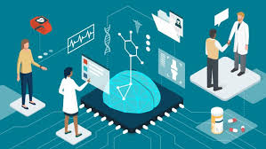

tHEMES

Slide 10
Theme: pRIVACY
AI allows gathering, processing, and analyzing an amount of data that would have been unthinkable just a few years ago, including vast amount of private citizen information
Private corporations accumulate loads of data on you, from your travel patterns to your biometric information
Data ownership? Data protection?

Slide 11
Theme: eTHICS
Computers are now taking on social responsibilities, helping determine who gets credit, who can be released early from prison, who committed a traffic violation, etc.
How can we determine the right balance between efficiency and transparency? Can this be made safely?
What happens when machines reach super-intelligence, or general-AI? Could this threaten us? If machines reach human levels of intelligence, should they gain rights and moral status?
Who is responsible for machine biases and mistakes? What about if a killer-robot makes a mistake?

Slide 12
Theme: biases
AI makes mistakes, but not all have the same consequences
  A bad Netflix recommendation
  Biased credit ratings
  Bail hearing & MachineBias Reports
Algorithms are often portrayed as « neutral » or « objective »… but algorithms are the product of the data they are fed (which might be biased), and the biases of their creators.
Blind reverence to AI as a neutral fix-all solution to social problems risks reproducing existing biases with the imprimatur of impartiality

Slide 13
Theme: regulation (policy)
The role of legislators?
Data property? Transparency? Accountability?
Legislating on GAFAMs.
What to do with Privacy, Ethics, and Bias questions raised by AI.

Slide 14
fiELDS

Slide 15
Field: Healthcare
Many promises: quicker more precise diagnostics, fairer triage, etc.
Very personal and private data
Who is responsible for a deadly AI medical mistake? The doctor? The engineer who designed the AI? The hospital ownership ?
Huge inequalities

Slide 16
Field: Algorithmic Policing
The use of algorithms and AI to enhance – and potentially transform – police decision-making practices
  Use mass data to inform daily operations
  Potential benefits include increased safety of our communities, more efficient and proactive organizations, reducing police biase, accountability
  Potential downfal include increasing police biases, unaccountability, mass surveillance, privacy and civil rights violations
  The risk of biased historical police data enhancing past discriminatory practices

Slide 17
Field: ECONOMY
AI as increasing the north-south gaps
AI replacing work… or workers?
What type of jobs are being replaced? What types are being created?
How to deal with Amazon? Uber?

Slide 18
Initial reflection paper (5%)
Due: By class start, 9:59AM, Friday Jan 28. Documents must be uploaded to Moodle in PDF.
Task: To reflect upon your career so far as a Social Sciences student at Dawson College.
Format: MLA “Cover” page. Times New Roman, size 12 font, double-spaced
Length: 250-350 words

Slide 19
Initial reflection paper
What skills have you learned in your Social Science courses?
What sort of links or overlaps have you perceived between your Social Science courses at Dawson? For example, do similar themes and issues keep coming up in different courses?
Without mentioning teachers by name, from which courses have you benefited the most?
You might also mention aspects you feel you learned poorly or not at all.
How has your experience at Dawson as a Social Science student changed you and how you look at the world?
Which of your social science courses do you think had the most effect on this change? How and why? Was it primarily the subject? The methodology? The teacher?
At the end of this reflection on your social science “career” at Dawson, you must indicate a potential theme / field (or two) that interests you and may be explored in your project. Explain why it interests you.

Slide 20
IS CLASS 3
We will go more in depth on AI themes
Help precise subjects.
Different disciplines, and how they can be used for different subjects
Give examples on Algorithmic Policing

Slide 21
IS cLASS 3

Slide 22
Algorithmic policing

Slide 23
Outline
What is AI ? What is Policing ? What is Algorithmic Policing?
Object Recognition Software
Particularities of Police AI Policy – and what to avoid
Democratic Algorithmic Policing Concerns
  Privacy
  Algorithmic Bias
Algorithmic Policing in Canada
  Everyday AI
  Predictive Policing in Vancouver
  Body Worn Cameras

Slide 24
What is policing
The ”armed arm of the State”
  Weber’s definition of the State
  A Police “service” ; “force” ; ”agency”; “department” ; “organization” ?
From the use of force to the capacity to use force (Brodeur)
  What is force?
  How does AI influence this capacity - this power
Police discretion and the centrality of decision making (Monjardet)
The independent – insular pendulum: keeping the police close, but not too close

Slide 25
Algorithmic Policing
The use of algorithms and AI to enhance – and potentially transform – police decision-making practices
  Use mass data to inform daily operations
  Potential benefits include increased safety of our communities, more efficient and proactive organizations, reducing police biase, accountability
  Potential downfal include increasing police biases, unaccountability, mass surveillance, privacy and civil rights violations

Slide 26
Activity
Take your phone out
Search “Google Quickdraw” on your internet browser

Slide 27
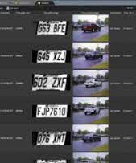
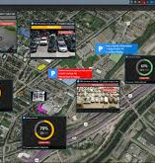
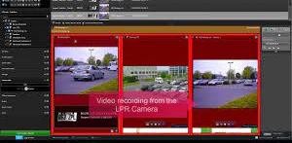
Object Recognition Software (1)
Automatic Licence Plate Readers
  10 years of AI in Canadian policing
  SPVM: among the firsts in Canada
  The industry leader: Genetec (Montreal based)
    Stance on China
  Images taken from Genetec Autovu promotional material

Slide 28
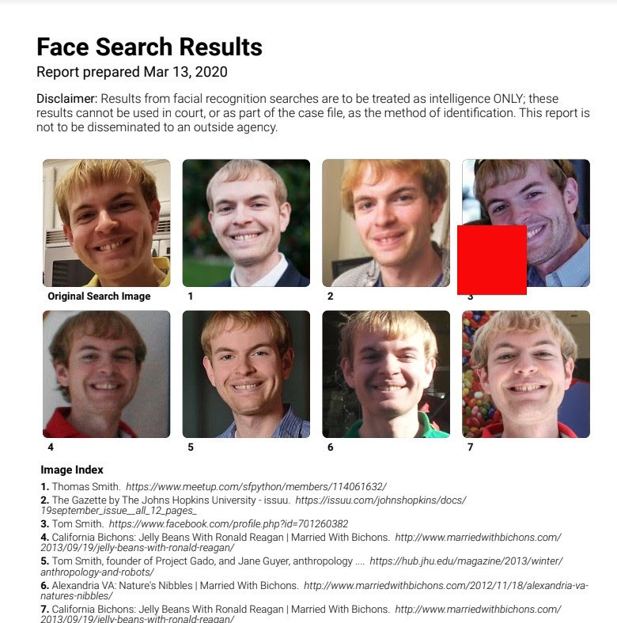
Object Recognition Software (2)
Facial Recognition in Canadian Policing
  Since 2014 in Calgary, Toronto, etc… Despite over 4% error rates!
  Since 2020 in Quebec, Sûreté du Québec
  Mugshot database, now 0.08% error rates
Winter 2020 Clearview AI scandal
  48 Clients including the RCMP, TPS, VPD, etc.
  Social Media databases
  AI in policing studently becomes a scary prospect for the general public
T Smith, OneZero.medium

Slide 29
Particularities of policing
Algorithmic Policing cannot be treated as just another AI Policy field
Policing as a unique government responsibility. One which enables an institution to surveil and use coercive force to restrain civil liberties
AI can completely transform how our societies are policed, the invasiveness of which cannot be understated. This is fundamentally a democratic question. At its core: the power balance between citizens and their police.

Slide 30
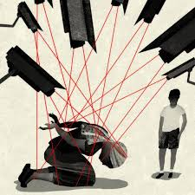
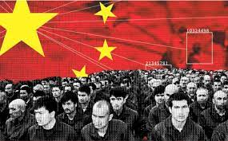
Chinese Police State & the Uyghurs

Slide 31
Algorithmic Policing in a democratic context
What are the big issues to consider ?
  Privacy
  Algorithmic Biases
What forms of algorithmic policing are in use in Canada?
Are governments encouraging this ? Are they regulating it ?

Slide 32
pRIVACY CONCERNS
Traditional limits to police power
  Resources limitations (time, manpower, cost)
  Public oversight of the police
AI allows gathering, processing, and analyzing an amount of data that would have been unthinkable just a few years ago, including vast amount of private citizen information
Dragnet surveillance: widening the police database inclusion “trigger mechanism”
  Inexpensive, and behind screens.

Slide 33
Algorithmic biases & policing
Algorithms are the product of the data their are fed, and the biases of their creators.
  Facial Recognition and non-white faces
AI makes mistakes, but not all have the same consequences
  A bad Netflix recommendation
  Biased credit ratings
  The arrest of black individuals based on faulty FRS
  Bail hearing & MachineBias Reports

Slide 34
everyday AI in Canadian Policing
Ai is used everyday for clerical effectiveness
  Automatic transcription
  Scheduling
  ALPRs since 2009
  = more officers in the streets, preventing crime and doing community policing
But what about other, more controversial Police uses of AI?
  Facial Recognition
  Predictive Policing
  Body Worn Camera – and their footage

Slide 35
Predictive Policing
The use of historical data to forecast where crimes are likely to occur or by whom to deter them before they happen
Historical data, especially in a policing context, might be particularly biased
Can lead to the continued overpolicing of marginal communities with the apparance of algorithmic impartiality

Slide 36
Vancouver police –2019-202…
Placed-Based Predictive Policing that impacts daily policing practices
  Deep learning / Machine learning. By Definition, this means even the VPD does not know what is taken into account to make predictions
  Adoption process with limited overseight
  Took preliminary (unconvincing) data as proof of concept
Dealing with potential biases
  Only includes crime datapoints reported by citizens, but what about their biases? Re: the central park birdwatcher incident
  No external verification

Slide 37
From where to who
LAPD PredPol Fiasco
  STOP LAPD Spying Coalition
Person-Based Applications ’’for good’’ in Saskatchewan
  Missing children
  Privacy implications
  Colalboration with Universities to legitimize increased police surveillance

