Slide 1
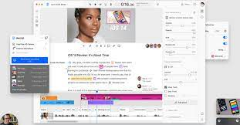
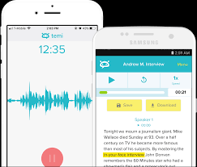
Automatic Transcription Software (ATS)
PED Day – October 2021
Dawson College
Michel Fournier-Simard

Slide 2
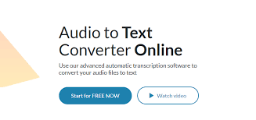
Automatic Transcription Software
Uses voice and speech recognition technology to convert audio and/or video files into a written format
Feeds on high-quality datasets
Mature technology
Accepted practice in academia
Huge efficiency gains
Things to think about:
Cost
What you lose by using an ATS
- Ethics / data security

Slide 3







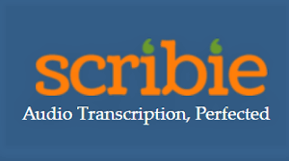
Uses in a CEGEP classroom
RM or Humanities classes that ask students to conduct interviews
Language classes
Any asynchronous recorded content shared with students (subtitles)

Slide 4
Happy Scribe
Free trial (no credit card)
Web-Based (no app)
Transcripts & Subtitles
Languages & translation integrated
English & French
Easy to use
Update December 2021: Now only offers 10 minutes for free instead of an hour.

Slide 5
Update December 2021
Software prices / free trials change all the time, need to verify every semester
Alternatives that include up to 40 minutes transcription for free include
  trint.com
  sonix.ai
  Word online (used by many of my students).

