Slide 1
Automatic Text Generation Systems: A Brief History
Daniel Pomerantz

Slide 2
Text Generation : What is it FOR
Text generation applications are within the realm of natural language generation
Highly related to natural language processing
The idea is to generate text automatically and ideally in as human like a way as possible
Several approaches:
random
template based
predictive: examine surrounding words

Slide 3
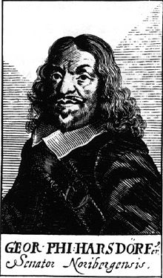
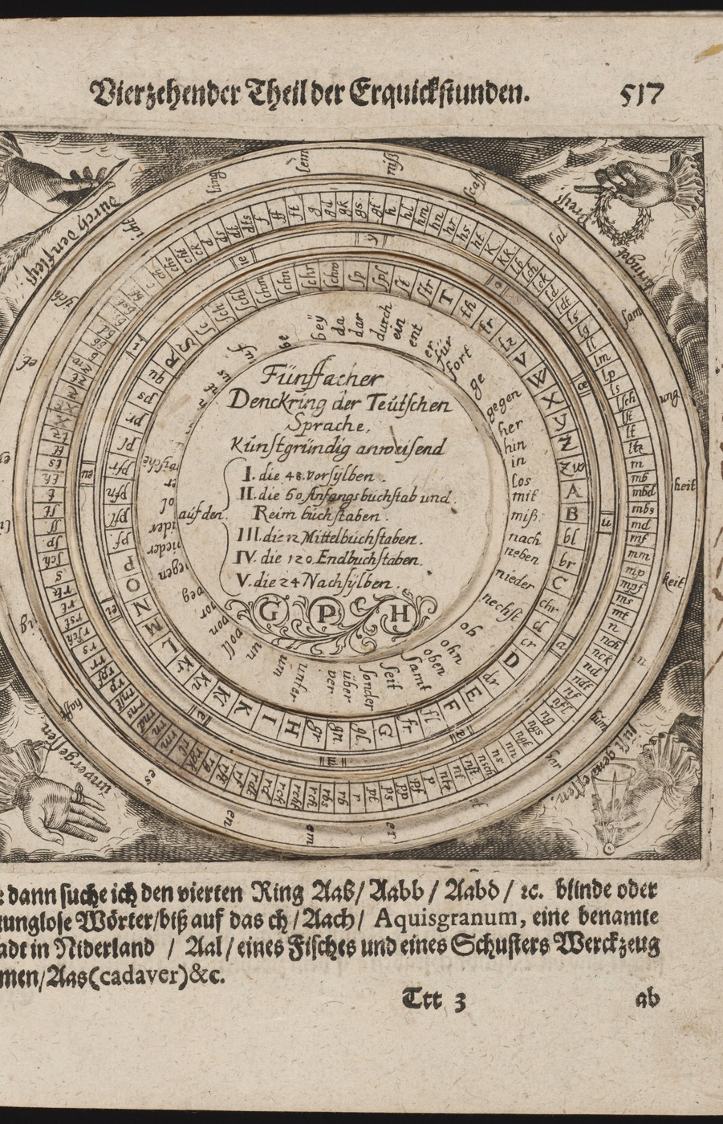
Historically
Georg Philipp Harsdorffer (1607 - 1658)
German poet
Notes:
Georg Philipp Harsdorffer
-Experimented with auto text generation using a die. Each side of the die contained a different letter and could be used to generate text this way
-The picture on the right is "The Five Fold Thought ring of the German Language" and contains 5 concentric circles. You spin these circles (independently). Each circle contains various parts of the word (e.g. stem, middle letters, suffix, etc)
-You can also imagine a text generation system that involves 3 "die" One for subject nouns, one for verbs, and one for direct object nouns
-We could say that this is an "AI" without the hardware
Src: http://mathesonmarcault.com/index.php/2015/12/15/randomly-generated-title-goes-here/

Slide 4
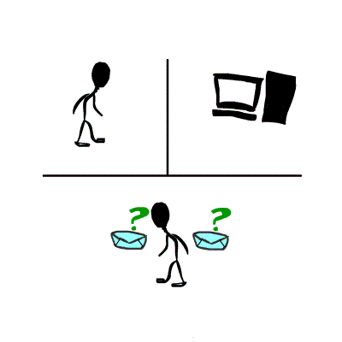
Turing test (a.k.a. The Imitation Game) - 1950
https://commons.wikimedia.org/wiki/File:Turing-test.gif
Notes:
There is an important concept in artificial intelligence called the Turing Test.
The idea is that an artificial intelligence is considered to pass the Turing test if a person is unable to determine which of the 2 speakers they are interacting with is human and which is a machine
So this is the goal with a text generation system

Slide 5
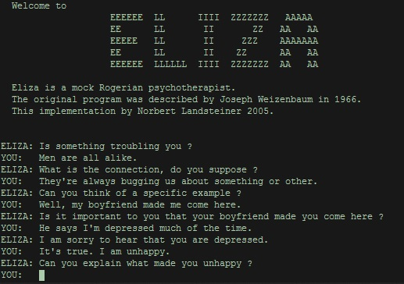
Chat Bot : Eliza
Created 1964-1966 at MIT
Followed a "script"
Meant to provide a parody of "the responses of a non-directional psychotherapist in an initial psychiatric interview"
Users attributed human-like feelings to the computer program and some believed it was a human
https://en.wikipedia.org/wiki/ELIZA#/media/File:ELIZA_conversation.jpg

Slide 6
Chat Patient : Parry
Created in 1972
Described as "ELIZA with attitude"
Attempted to model the behavior of a paranoid schizophrenic
33 psychiatrists were shown transcripts of conversations, half of which were from PARRY, half from real patients
48% correct identification --> Turing test!

Slide 7
When PARRY Met SALLY Eliza
ELIZA: Good Evening. Tell me your problems. Please terminate input with a period or a question mark.
PARRY: People get on my nerves sometimes.
ELIZA: I am not sure I understand you fully.
PARRY: You should pay more attention.
ELIZA: Suppose you should pay more attention.
PARRY: You're entitled to your own opinion.
ELIZA: What makes you think I am entitled to my own opinion?
PARRY: It bothers me just to be around people in general.
ELIZA: Please go on.
PARRY: I went to the track at Bay Meadows a while back.
ELIZA: What does that suggest to you?
PARRY: I went to the races.
Entire transcript: https://tools.ietf.org/html/rfc439

Slide 8
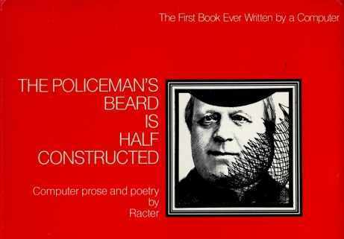
The Policeman's Beard is Half Constructed (1984)
A book written by an artificial intelligence
"More than iron, more than lead, more than gold I need electricity. I need it more than I need lamb or pork or lettuce or cucumber. I need it for my dreams."

Slide 9
2005: The Pollen Forecast for Scotland
Similar to a template (i.e. madlibs)

Slide 10
Turing Test : Which is the AI?
Grass pollen levels for Friday have increased from the moderate to high levels of yesterday with values of around 6 to 7 across most parts of the country. However, in Northern areas, pollen levels will be moderate with values of 4.
Pollen counts are expected to remain high at level 6 over most of Scotland, and even level 7 in the south east. The only relief is in the Northern Isles and far northeast of mainland Scotland with medium levels of pollen count.

Slide 11
Turing Test : Which is the AI?
Grass pollen levels for Friday have increased from the moderate to high levels of yesterday with values of around 6 to 7 across most parts of the country. However, in Northern areas, pollen levels will be moderate with values of 4.
Pollen counts are expected to remain high at level 6 over most of Scotland, and even level 7 in the south east. The only relief is in the Northern Isles and far northeast of mainland Scotland with medium levels of pollen count.

Slide 12
Today: News Articles
Sports recaps
Weather
Financial reports
Real estate analysis

Slide 13
Stat Sheet / Automated Insights / STATS
Started in 2007 providing statistics for sports
No human journalist, blogger or writer
Associated Press used it to automate NCAA Division 1 men's basketball previews for entire 2018 season
AP claims it allowed journalists to focus on more in depth articles by freeing up 20% of journalist's time spent normally writing recaps
Yahoo Sports does something similar
ESports opens up an amusing possibility

