Slide 1

Goals for Release
Daniel Pomerantz

Slide 2
Agenda
Goals of release
Approach
Status / Sample slides
Questions / Feedback

Slide 3
Goals of Release : Background
Currently, there is a complementary course "Intro to Computers" in the computer science department
Approximately 5-7 sections per term with 32 students each
This course is, for the most part, an outdated course that covers Microsoft Office suite
  Useful skills (especially Excel), but most students already know how to make a Word document. So a lot of course time is a waste for most students.
  Course is extremely important for students who have not had the privilege of growing up with computers. However, each semester there are usually only 3 or 4 students (at most) like this

Slide 4
Goals of Release : New Course (existing Course Number)
The ministry requirements are very broad and we can use the existing course framework to create a new course
A course to help students become "informed citizens" on issues related to computers will benefit more students
Not necessarily exclusive to AI, but AI is clearly an important part of such a course
Could keep one section of the course with the old Microsoft Office format

Slide 5
Informed Citizens
In order to become informed citizens, students need to do two things:
  Learn what the issues are
  Be able to have intelligent discussions about the issues.
    It is important that this include discussion about the negatives of the technologies, which usually involve ethics, something that I know nothing about.
    Understanding a little bit about how they work is useful.

Slide 6
AI Ethics Course
Students would spend lecture time learning about the topics
During lab periods, they would debate the ethical considerations of the technologies
For homework, they would do some readings/questions
They would write an essay about a selected topic (a ministerial requirement, but also a good idea)
There could be some sort of "debate club" or "mock trial" (TBD if this is feasible)

Slide 7
Release Goals
Produce a list of topics (about 6) that a teacher could choose from for the course (P0 goal)
For each topic in the sample list, produce slides (in "final form") that can be used for such a course defining the "what" as well as going over, broadly, some of the pros/cons (P0 goal)
Make a list of readings so that teachers/students can learn more about the topics. Students would have to read some of these materials throughout the term (P0 goal)
Have a more concrete idea of how the evaluation would be. (P1 goal)
    For essays, it's fairly obvious, but the "debate club" aspect is trickier
    Also, how many topics are feasible to fit into a course?
Study ethics from the perspective of learning a couple frameworks (P2 goal)
    Utilitarian? Individualism? Some other framework? etc. It would be useful for students to speak more formally about whether something is "good" or "bad"

Slide 8
Approach
Release time is instead of a 45 hour course
To avoid procrastinating, I put into my calendar 3 hours and 12 minutes ☺ per week as if it were a regular class
Additional time spent since teaching isn't just showing up, but at least pre-allocating some time this way will ensure I don't skip it entirely any weeks

Slide 9
Step 1
Compile a list of potential topics. This list can be added to as I go
Expectation is that the initial list will be updated quite a bit (topics merged, split up, etc)
Topic list doesn't necessarily have to be limited to a 45 hour course

Slide 10
Step 2
For each topic, produce a very basic set of slides.
The slides will cover the "what" of an issue along with a very high level outline of the pros and cons of the topic
    Essentially, this is the "Wikipedia slides"
As the semester continues (and further after that), the intention is to be able to add to these
Try to have "food for thought" questions at the end of each deck. These could translate into assignment questions, debate topics, etc

Slide 11
Step 3
Learn about each of these topics and the trade-offs in more depth than I currently know
  I'd like to discuss the issues at a depth more detailed than "privacy is good!"
Start building up a bibliography and further reading for each of the slides
This will involve researching to find articles, etc as well as reading them myself
While doing this, add some learning activities to structure the slides in a better way

Slide 12
Where I'm at : initial List Of Topics
Big Data
Facial Recognition
Online Privacy / Big Brother
Self-Driving Cars
Distance based medicine
Pandemic
Deep fakes
Bias in machine learning algorithm

Slide 13
Some Sample Slides

Slide 14
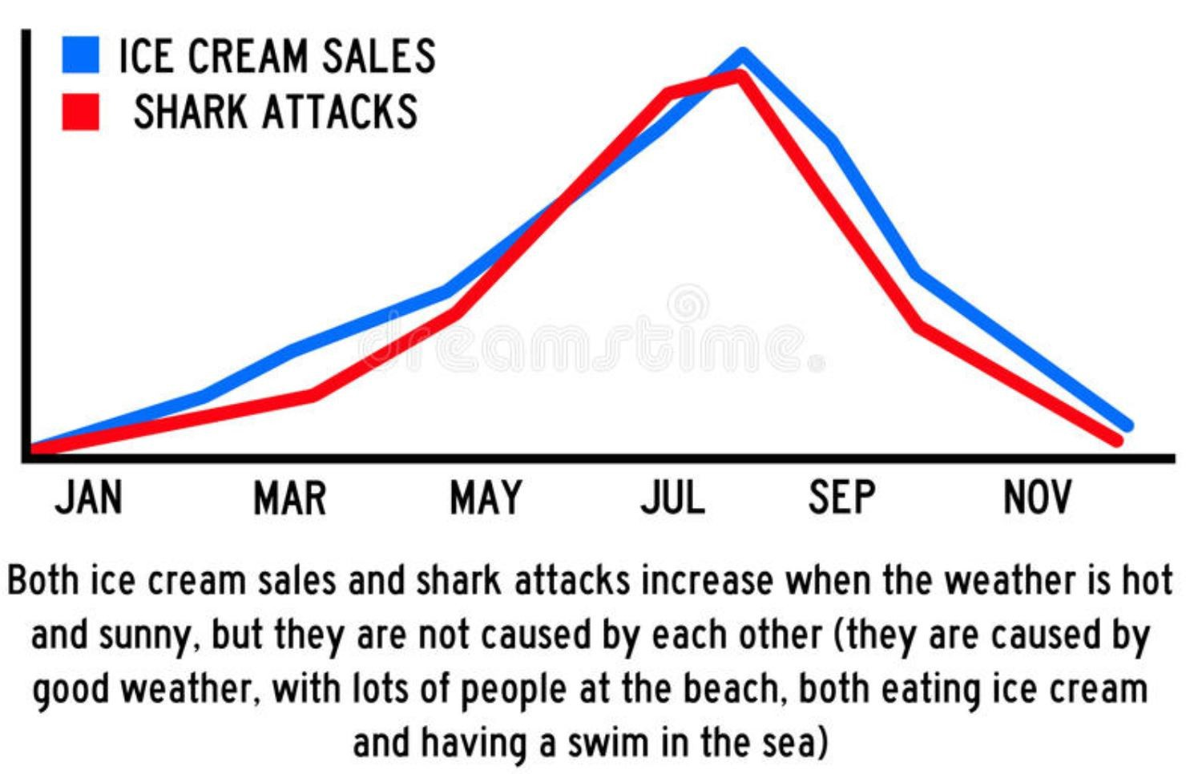
Correlation is not Causation!
Sample slide : Con of using big data thoughtlessly
https://www.kdnuggets.com/2019/09/risk-ai-big-data.html

Slide 15
SAMPLE Activity (BIG data)
Suppose you want to use analytics to predict the stock market. You run a computer algorithm to look at all of Microsoft stock prices since the year 2000. The computer comes up with the following rule. Is this rule a good rule or not?
"Microsoft stock will increase if the day is January 2nd, 2000 OR January 3rd, 2000 OR January 6th 2000, OR January 10th 2000, OR etc.

Slide 16
Sample Activity (Big Data): Are these good?
At the University of Alabama, data analysis found that students who asked for their transcripts were at risk of dropping out of school. In response, school administrators decided to offer more resources to all students who request transcripts
At Georgia State University, they used analytical tools to give academic counselors information sooner, again to highlight struggling students. According to the school, graduation rates among African Americans and Hispanic students increased from 18% to 55% after doing this. One administration official was quoted as saying, “As soon as a student makes a wrong turn, the system’s already recalibrating to get him or her back on the right path."
Srcs: https://edtechmagazine.com/higher/article/2019/08/what-can-real-time-data-analytics-do-higher-education-perfcon and https://edtechmagazine.com/higher/article/2019/05/universities-use-data-analytics-tools-support-academic-advising
Notes:
This is unclear. On the one hand, the people seem well intentioned and it certainly is believable that people often request their transcripts because they are looking to switch schools, which may be an indication they are performing poorly. On the other hand, there are also many other reasons people would request a transcript, and this will be needlessly targeting them, wasting resources, etc. It is very much "big brother"

Slide 17
Questions for Thought
Sample slide : Food for thought about facial recognition
Is it ethical for parents to post pictures of their children on Facebook? Is it ethical for Facebook to store these photos?
CCTVs can be used to catch criminals. However, they can also be used to “catch” protesters. How do we decide where to install CCTVs?
Do software companies have an ethical responsibility?
Are you worried about this?
What are some potential concerns about this technology for our legal system?

Slide 18
Questions / Feedback

