Slide 1
UNIVERSAL DESIGN OF LEARNING (U.D.L.) By: Cathy Nickson

Slide 2
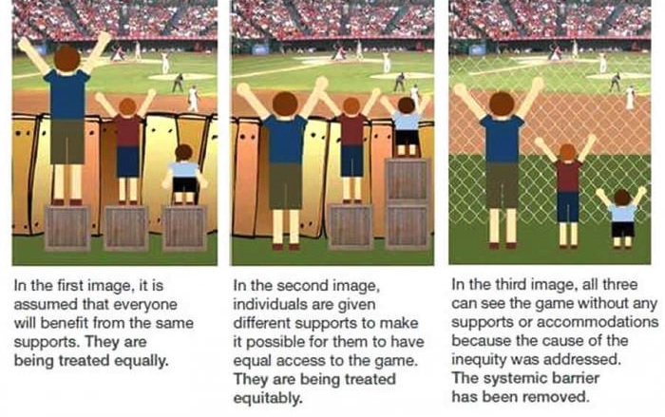
The goal of U.D.L.
reduce the barriers to learning and take into consideration all types of learners.
http://spark.adobe.com
http://spark.adobe.com
http://spark.adobe.com
https://spark.adobe.com/page/pSjTM/images/bf29c67d-74c5-4f4b-8ad9-ca43729d419a.jpg?asset_id=67ccecb3-cc93-4dd6-a8e5-901d5955d32c&img_etag=8a545a0d3f398bc4af5b01ae7c151be4&size=1024

Slide 3
Principles of U.D.L.
Provide Multiple Means of ENGAGEMENT ***************** Motivate and stimulate the students so that they are engaged in the learning process. | Provide Multiple Means of REPRESENTATION ******************** Present information in different formats to the students. | Provide Multiple Means of ACTION & EXPRESSION ************************** Provide different options to the students to demonstrate learning.

Slide 4
MY GOAL
.. to consider the needs and abilities of all of my students and remove the barriers to learning in my resistance training course.

Slide 5
Barriers To Learning in P.E Classes
Language skills * Visual Impairment
Hearing loss * Mobility Issues
Physical injury * Cultural background
Attention disorders * Social skills
Motivational level * Anxiety levels
Learning disabilities * Mobility Issues
Neurological disorders * Age

Slide 6
Methods of Engagement
I incorporated more fun activities into the class. i.e. scavenger hunts, star fitness, card workouts, partner workouts, team workouts, name workouts, sally squats.

Slide 7
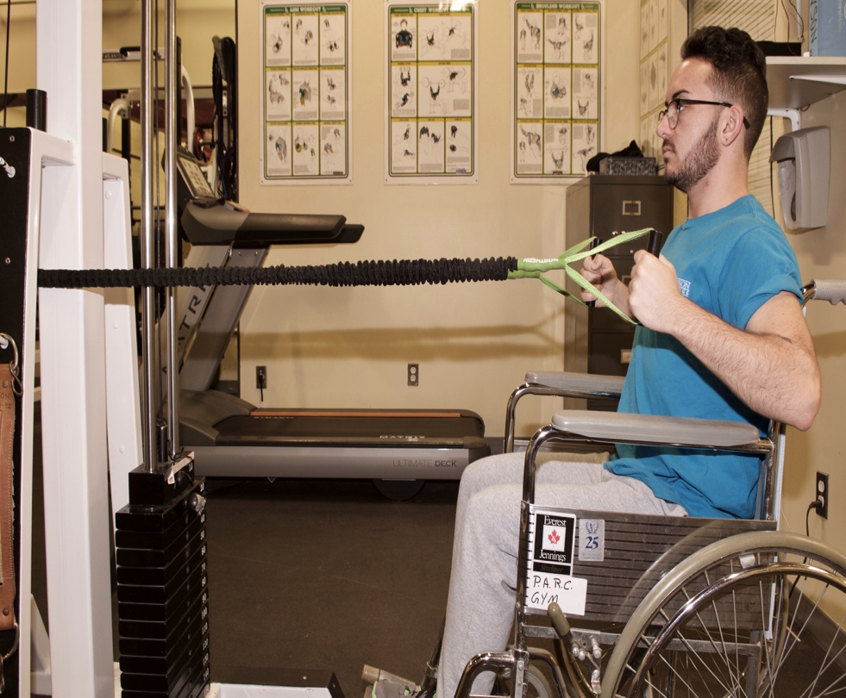
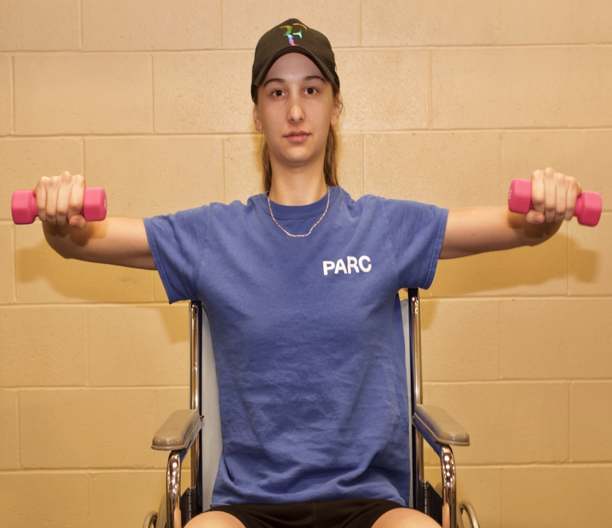
Exercise programs were designed based on individual needs and abilities.

Slide 8
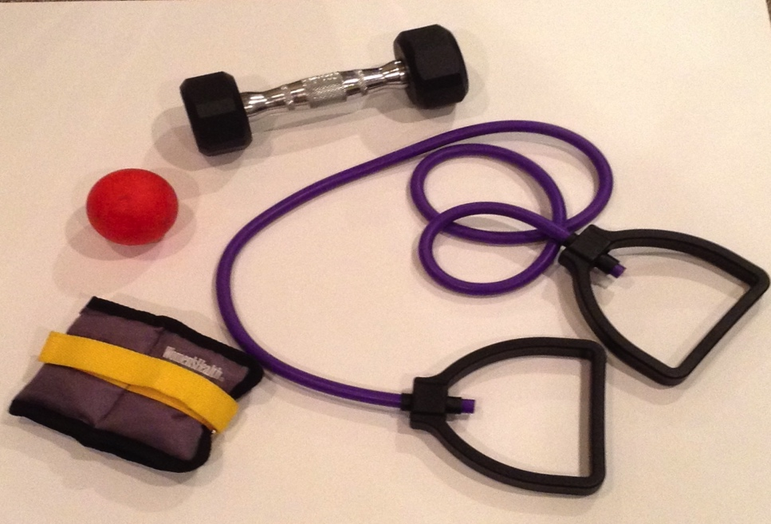
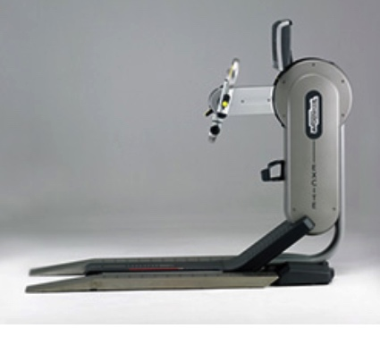
Equipment was purchased for all students.
Lighter weights, pilate bands, wrist weights, tubing, grip strengthener.
Hand Cycle

Slide 9
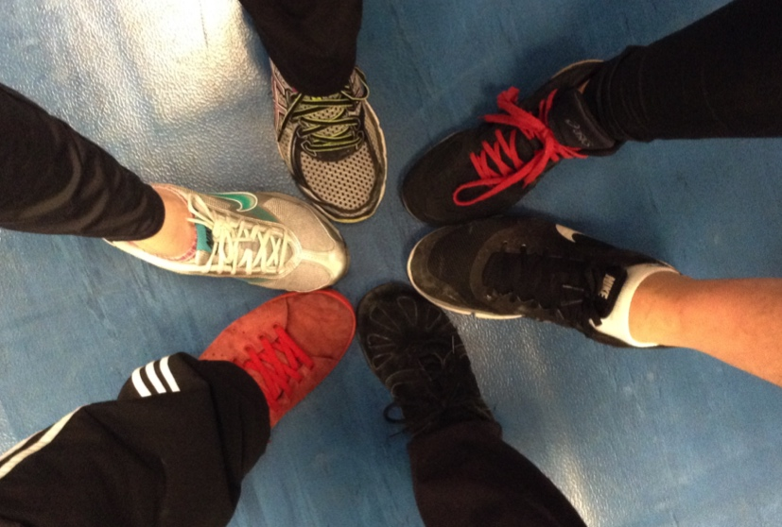
Students could work out individually or with a partner.
Group interactions and discussions were
encouraged.

Slide 10
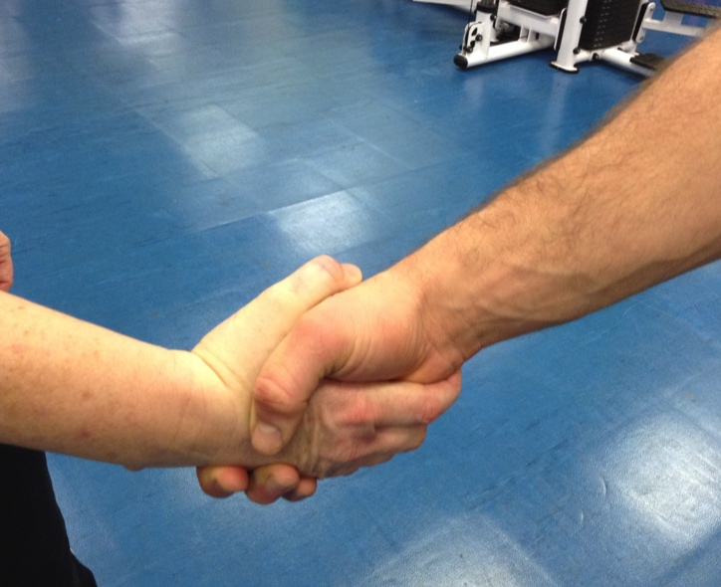
Content was made relevant and meaningful to their life.
Activities changed each week.
Participation was assessed and not ability.

Slide 11
Methods of Representation
Information was presented via voice, video or print (computer ,blackboard, Lea, manual)
Power points were created for my course outlines (see next slide) and theoretical sessions. They were put on Lea for students to review.

Slide 12
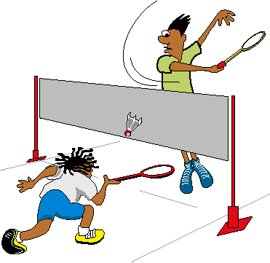
Main objectives of this course
To improve in your Badminton Abilities
Technical (Strokes)
Tactical ( Strategy)
Physical
Mental
Attitudinal

Slide 13
The power points were created with U.D.L principles in mind.
size of font and type of font.
number of words per line
contrast text and background
using visuals

Slide 14
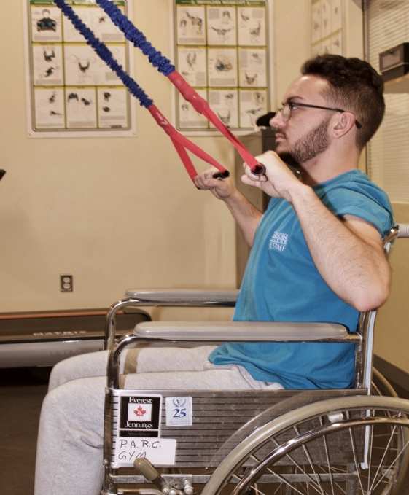
Weight training visuals were created for students with mobility issues or those who have lower body injuries.
Images belong to Cathy Nickson

Slide 15
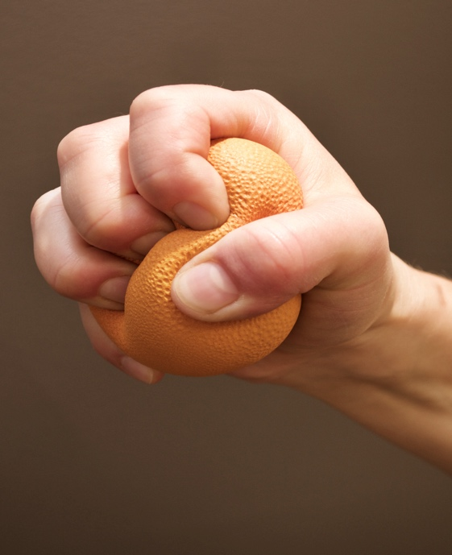
Worksheets were created on finger/hand workouts for mobility impaired students.
Images belong to Cathy Nickson

Slide 16
A digital copy of the manual is available to students who need it through the AccessAbility center.
Wheel chair exercises and visuals for mobility impaired students will be put in the 109-101 MQ manual

Slide 17
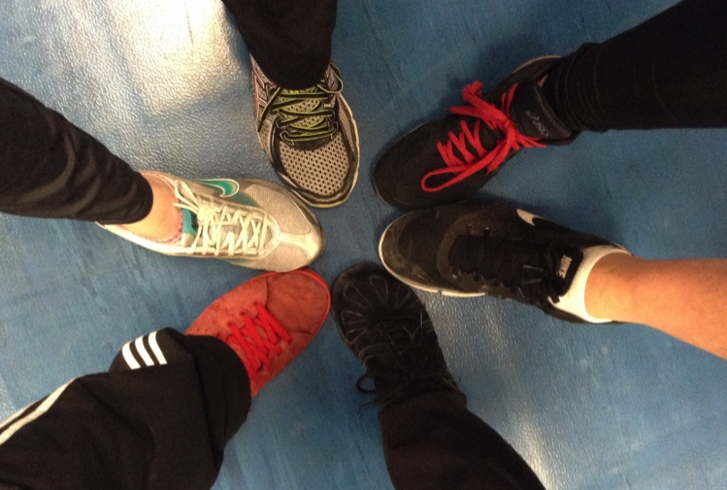
My course outlines will now include this statement:
“This is an inclusive learning environment. If you experience barriers to learning or have any concerns, do not hesitate to discuss them with me.”

Slide 18
Methods of Expression
There were multiple methods of assessments. (class participation, written assignments, class worksheets, review test)
Students were given choices for homework worksheets.
http://blogs.lt.vt.edu/laurak89/files/2014/04/Choice.jpg

Slide 19
Students could record, write, or video their answers on their assignments.

Slide 20
Students were given a choice to take or create a test in order to review the material learned.
There were multiple types of questions on the test: (short answer, true and false, multiple choice, matching etc.)

Slide 21
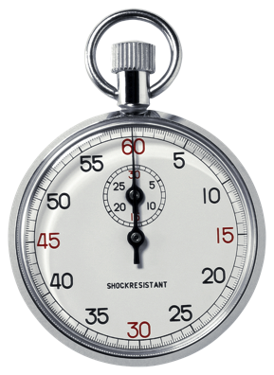
Students could write the test in the classroom, if they needed less distraction.
Mobility impaired students could have their assistants read the test to them.
Extra time was given so that every student could use it if needed.

Slide 22
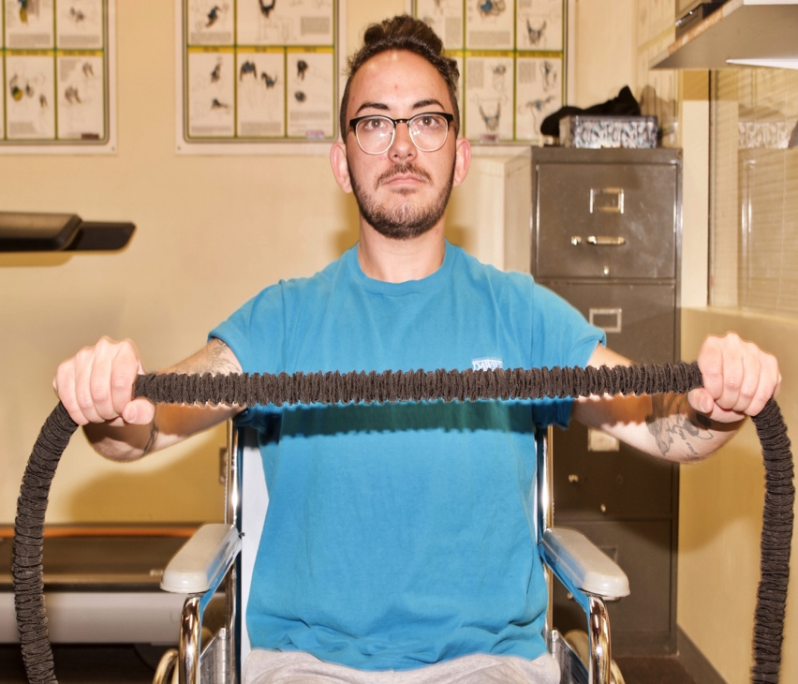
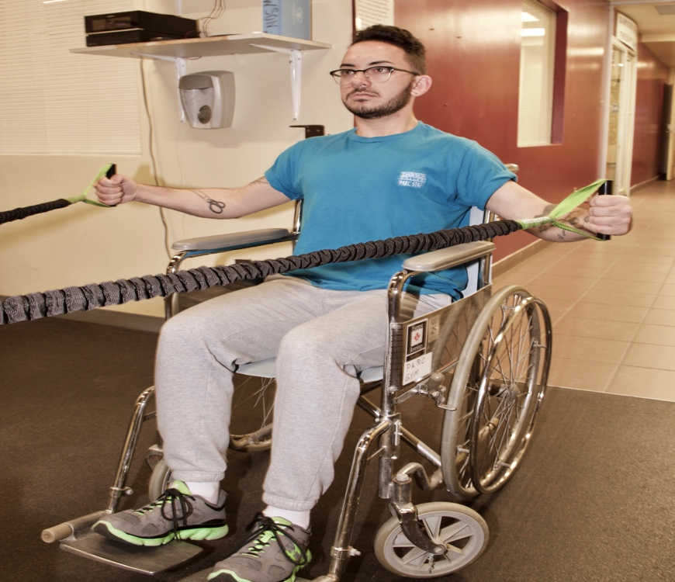
Students were given choices of exercises within exercise programs.

