Slide 1

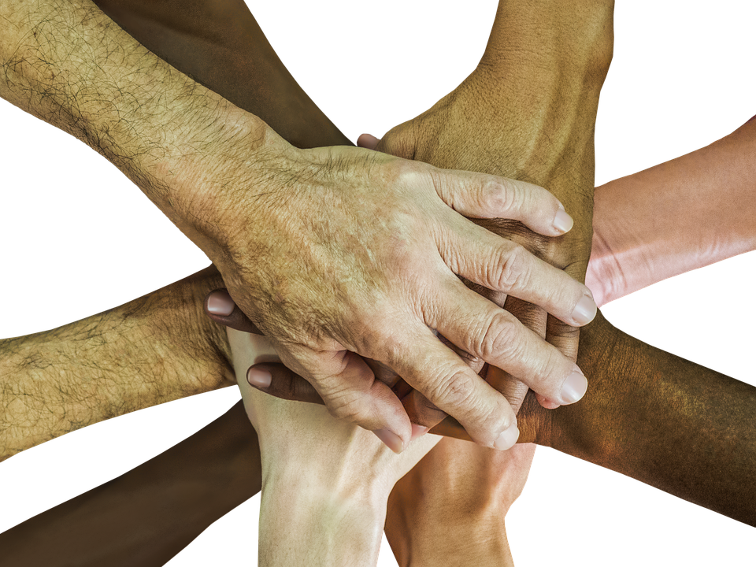
Universal Design For Learning in
Physical Education
My UDL Journey
Prepared by Caroline Haddad
March 3, 2023

Slide 2
What Inspired Me To Universal Design For Learning?
I was inspired by the interactive workshop and how the presenters showcased their strategies to involve ALL their students. I was motivated to learn more about UDL and wanted to be able to use the UDL guidelines in my own classes.

Slide 3
UDL AT A GLANCE
UDL At A Glance - YouTube
(4:35)

Slide 4
What Is Univeral Design For Learning (UDL)?
Designed by CAST (Center for Applied Special Technology) - nonprofit education research and development organization in Boston
UDL is an Educational framework
"goal is to help educators develop a learning environment that reduces student barriers and motivates them to succeed"
"to create learners who are purposeful & motivated, resourceful & knowledgeable, and strategic & goal oriented, in other words, expert learners"

Slide 5

Three P.E. Competencies:
101 MQ Physical Activity & Health:
Lifestyle behaviors that promote health
102 MQ Physical Activity & Effectiveness:
Improve effectiveness when practicing physical activity
103 MQ Physical Activity & Autonomy:
Demonstrate the ability to manage health-enhancing physical activity

Slide 6
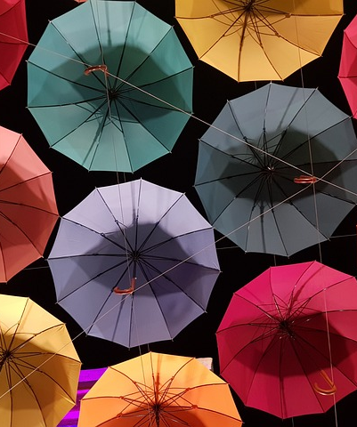
My Goal
Dawson has a diverse cultural student body. I wanted to incorporate ways to have students (especially first year students) feel comfortable & confident being in a PE class.
  I selected one of the competency elements in the 101 PE level:
  “Recognition of the influence of social and cultural factors on the practice of physical activity.”
  This challenged me in searching for a variety of ways I can help “break the ice” -
  so students can feel
  happy coming to class,
  challenged but successful, and
  safe to express themselves during physical activity.
Image by Heejin Jeong from Pixabay

Slide 7
Some of the steps I took to help me tackle the competency element of social & cultural integration in my courses:
I reflected about my own cultural background (for my personal knowledge).
I needed to know more about the present student cohort: Generation Z.
Provided assignments and assessments that offered choices for expression.
Used different games to encourage self-expression and trust among students.

Slide 8
This presentation will display some ideas and examples that I am applying using UDL principles.
PE courses that I'm focusing on for the purpose of this journey:
Alternative Fitness, Fitness Walking & Outdoor Fitness
I am no expert on every culture; however, being proactive in guiding my students to understand their own identity through physical activity and to experience physical activity through diverse perspectives will allow students and I to make connections.

Slide 9
Defining My Cultural Background
Gender
Sexual Orientation
Race
Ethnicity
Language
Religion

Slide 10
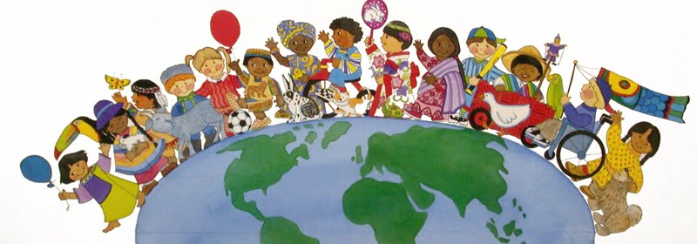
Cultural Integration Through P.E. in the 21st Century
Couple of Factors to Acknowledge:
Generation Z
Barriers
This Photo by Unknown author is licensed under CC BY.

Slide 11
Generation Z
Also Known As:
Phygitals (fusion of physical & digital),
Gen Zers, Zoomers, Centennials,
Postmillennial, iGen
Some Characteristics:
Motivated
Needs to do/action
Independent
Like a combination of teamwork & individual work
Plan for future
Realist
Problem solvers
Persistent

Slide 12
Biggest Surprise of Gen Z
“What type of communication do you like best?”
"We expected the interviewees to respond with their favorite type of digital communication – e.g., text, email, chat group, DM (direct message), FaceTime, Skype, etc. –
but instead nearly every single person said their favorite form of communication was “in person.”
Ref: What to know about Gen Z | Stanford News

Slide 13
In summary,
"...a typical Gen Zer is a self-driver who deeply cares about others, strives for a diverse community, is highly collaborative and social, values flexibility, relevance, authenticity and non-hierarchical leadership, and, while dismayed about inherited issues like climate change, has a pragmatic attitude about the work that has to be done to address those issues."
Ref: What to know about Gen Z | Stanford News

Slide 14
Some Barriers in a Multi-Cultural mixed-gender
PE Class
Gender
Race
Religion
Language
Clothing Appropriateness
Ethnic Background body modesty vs. Western youth culture (fitness, being sexy)
Changing Rooms
Whiteness in PE Teaching

Slide 15
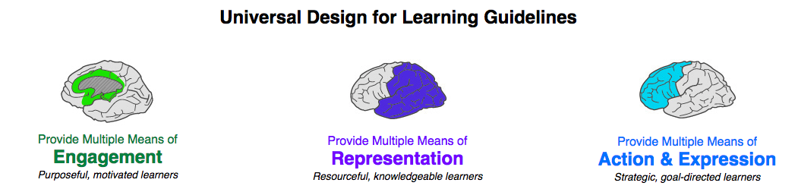
Why of learning? Goal is to help students be more aware of cultural diversity in class Ignite motivation Accessible to all students | What of learning? Criteria & info is clear to all students in various forms (visual, auditory) Include assignments that have cultural questions | How of learning? Students express themselves through self-reflection and through creative assignments Physically respond to games/activities performed in class to break barriers (e.g. ice-breakers)
This Photo by Unknown author is licensed under CC BY.

Slide 16
Methods of Engagement
Team Building
Scavenger hunt
Partner Fitness Appraisals
Partner workouts
Think-Pair-Share activities during theoretical portions
Walk & Talk during Fitness Walking (outdoors) "Buddy System"
Mini discussions about relationship between Food & Culture during nutrition lectures
Games
Selected some games from "Games for Actors & Non Actors" by Augusto Boal to break the ice, laugh, build trust make it safe, and be silly
Immediate verbal reflections/analysis after each game to learn from each other

Slide 17
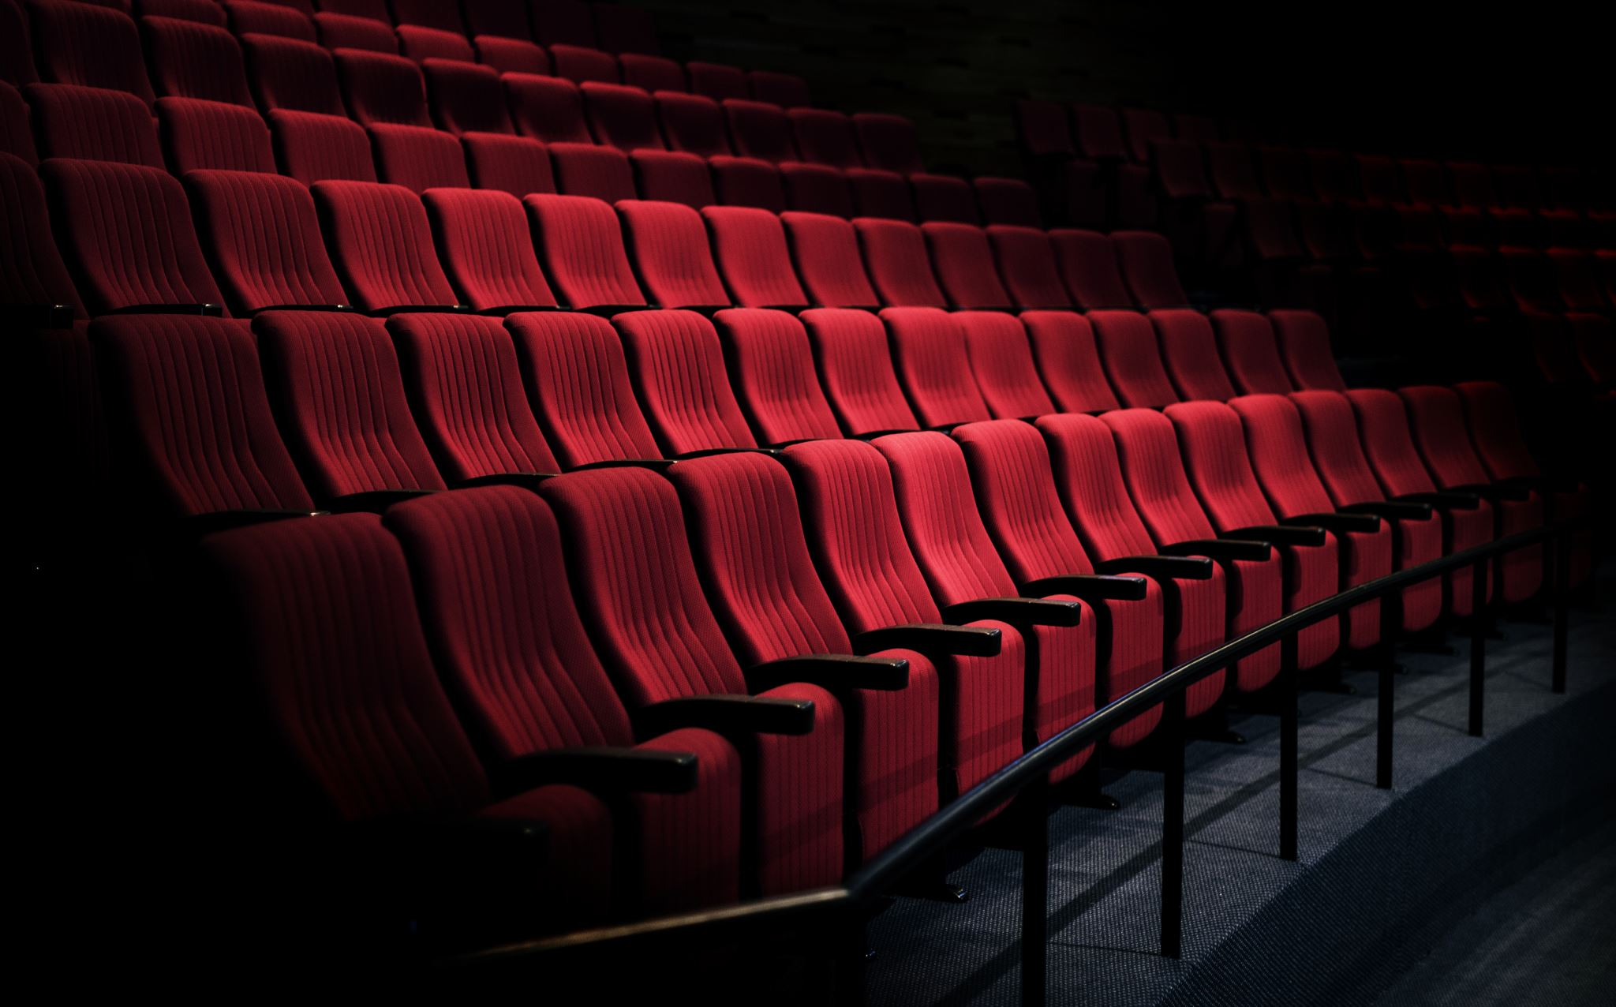
“Theatre is a form of knowledge; it should and can also be a means of transforming society." Augusto Boal

Slide 18
Methods Of Representation
The 101 Manual is now in a digital format as well as hard copy at the bookstore (at first it was only digital at the SAAC).
We are working on it to have the manual in an audio format.
The manual is being re-vamped to take UDL and EDI into consideration, change pictures to represent more inclusion of all ethnic backgrounds.
Students have access to PPTs prior to class (1 week or more), if they need to print, read before class all on LEA under Documents
Smartboard, blackboard, White board

Slide 19
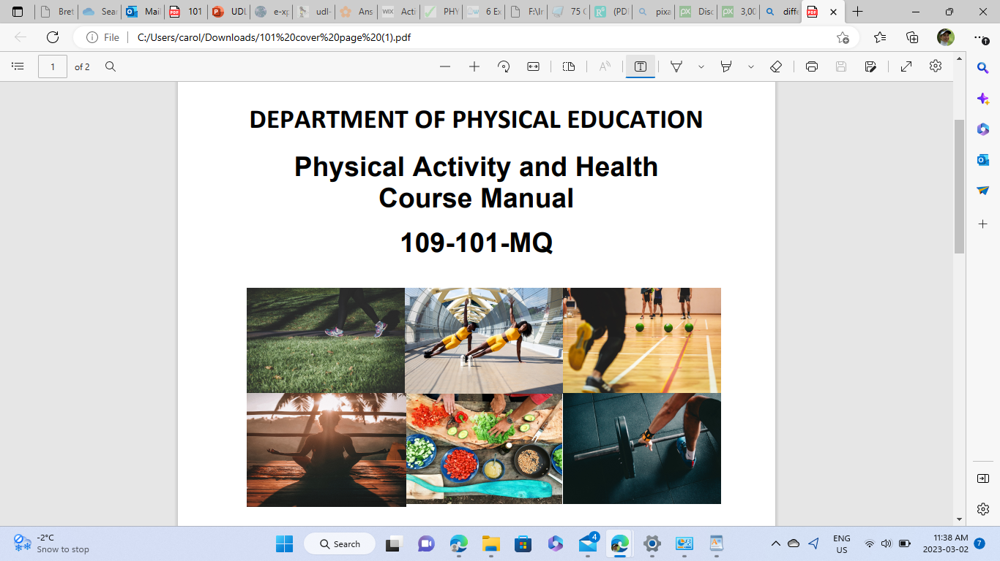

Slide 20

Action & Expression
Example of Assignments
Breton-Chang_2234211_Digital_Portfolio_Submitted_on_2022-12-06_15h18m46s (2).pdf (sharepoint.com)
https://luneria444.wixsite.com/portfolio

Slide 21
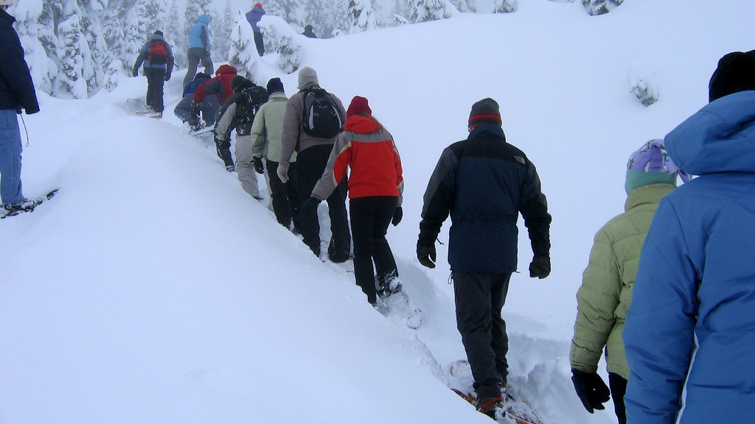
Quotes from student's portfolio assignment
"Snowshoeing is a very significant Canadian cultural activity. It was how people got around a long time ago. (the indigenous population) Canada is known for its winter season and therefore winter activities are valuable. It affected me personally because activities as such remind me of my Canadian blood and make me appreciate this country even more because of its uniqueness."
"Knowing that snowshoeing was a key contribution from Indigenous people to survive the harsh winters altered my perspective of Canada. The history of Indigenous people is often portrayed as one of horror, loss, secondary to the arrival of settlers. In spite of that, there is as much to celebrate, if not more, about the cultural contributions from Indigenous people. That is a vision I will carry as a Canadian Citizen."
This Photo by Unknown author is licensed under CC BY-SA-NC.

Slide 22

Quotes from student's portfolio assignment
".
"...ice skating is a popular sport in Canada, and being born here it is a must to be able to skate, it's basically in our blood. It's cold in Canada for about half of the year so therefore Canadians must figure something to entertain themselves during those dark times and ice skating is perfect.
It brings people together, you create bonds, you discover new stuff, and overall spend a great time and you end up forgetting about the cold."

Slide 23
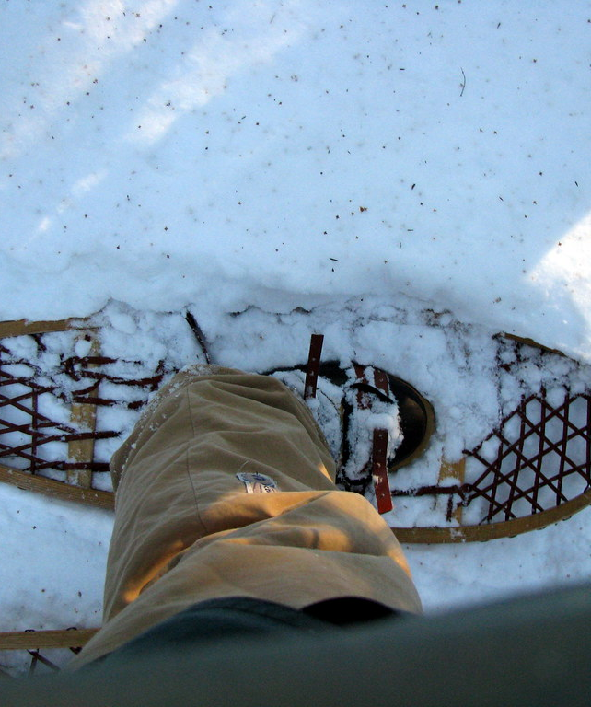
Quotes from student's portfolio assignment
"Snowshoeing is an integral part of Canada's cultural heritage, especially in the Northern parts of the country.
It is a form of winter transportation that has been used for centuries by Indigenous peoples and non-Indigenous people alike to traverse the snow-covered terrain. For many Indigenous communities, it is a means of connecting with the land, honoring their ancestors, and preserving traditional knowledge and practices. Snowshoeing has had a profound influence on me as a Canadian citizen. It has taught me to appreciate and respect the land, and to recognize the importance of physical activity in maintaining a healthy and balanced lifestyle. Snowshoeing has also allowed me to gain an appreciation for the hard work and dedication of the Indigenous peoples who continue to use this form of transportation on a daily basis. Finally, it has instilled in me a sense of pride and connection with the land and my Canadian heritage."
This Photo by Unknown author is licensed under CC BY-SA-NC.

Slide 24
"School needs to be a place where individual students can feel their whole self is welcome and valued-meaning their culture, language, gender, sexual orientation, race and ethnicity. And we need teachers and learners who know how to embrace those wonderfully varied individuals."
Linda F. Nathan

Slide 25

"School needs to be a place where individual students can feel their whole self is welcome and valued - meaning their culture, language, gender, sexual orientation, race and ethnicity. And we need teachers and learners who know how to embrace those wonderfully varied individuals."
Linda F. Nathan
Educator and Author

Slide 26
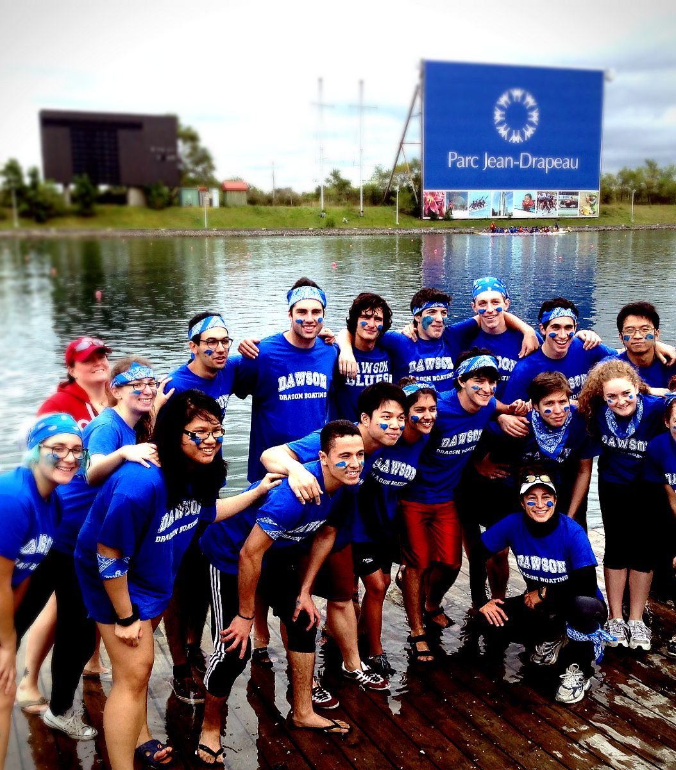
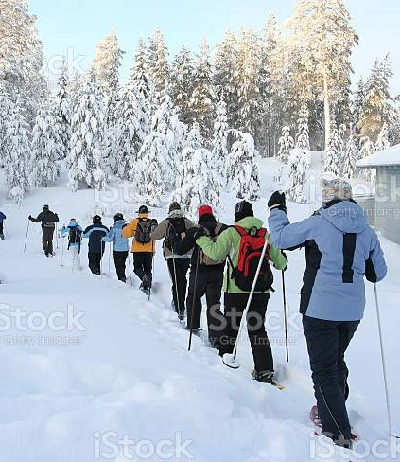
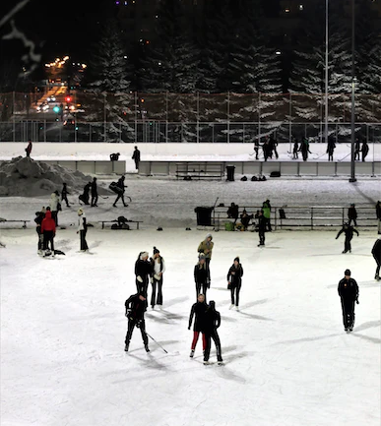
Cultural Integration through Physical Activity

Slide 27
Opportunity!
Having the opportunity to be part of the UDL committee was insightful, motivating and challenging! It has really helped me to think outside the box in preparing for my lessons, how to have firm goals and permit flexibility for diverse types of learners, as well as keep an open mind for change and different views.

Slide 28
Learning & Moving Forward
I look forward to continue applying what I learned from UDL and to learn more by collaborating with others in this Learning Community. In addition, it will be valuable to assure we keep our facilities user-friendly & accessible for all students. Our PE Dept. is very much involved with the Dawson SAAC and want to help make Phys Ed a successful experience for ALL students.
I learned from everyone, and particularly enjoyed being part of a diverse cohort from different departments.
I am very grateful that we have these amazing opportunities in-house to continue our teaching education.

Slide 29

This Photo by Unknown author is licensed under CC BY-NC-ND.

Slide 30
References
cultural competence | Cult of Pedagogy
What is Canadian cuisine? – Live & Learn (livelearn.ca)
Making-Presentations-Accessible-Through-Universal-Design-for-Learning.pdf (pandamn.org)
What to know about Gen Z | Stanford News
What is UDL? Infographic - Novak Educational Consulting
Symposium - Observer - Comprendre - Agir (symposium-generations.com)
Games for Actors and Non-actors, Second Edition (deepfun.com)

