Slide 1
My UDL JOURNEY LEAD ME TO S.A.A.F.I.
Johanne Rabbat
Dept. of Religious Studies

Slide 2
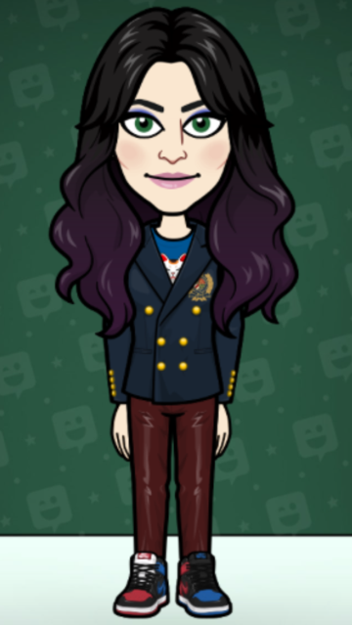
Learning about UDL during Pandemic Times

Slide 3
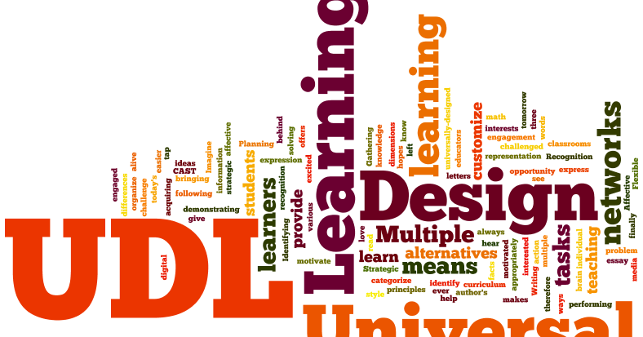
What UDL means to me…

Slide 4
This is one of the concepts that motivated me to want to learn more about UDL b/c it is one of my core values.

Slide 5
I also wanted to ensure that I was providing the best possible learning environment for my students, one that would not leave any of them behind.

Slide 6
My chief concern is with Equality, Diversity and Inclusion in the workplace and, of course, in the classroom.

Slide 7
As a student, my own experience has not always been one of EDI throughout my studies. It is thus so very important to me not to perpetuate any type of exclusionary practice in my classes.

Slide 8
Specific Challenges Posed in Teaching the Study of Religion

Slide 9
Specific Challenges Posed in Teaching the Study of Religion
Students may not be open to learning about faiths other than their own or believe that their faith is correct or true, while other beliefs and practices are invalid or false.
Certain topics in the study of religion are very sensitive and personal, and therefore difficult to navigate.
Some students may be intolerant to other students’ opinions, and/or beliefs and practices.
Some students may express their ideas or viewpoints without being respectful to other students, which can prevent other students from feeling safe to in turn express their own views, pose questions or ask for help or support.

Slide 10
These challenges lead me to the
2nd significant value I prize
guided by UDL principles …

Slide 11
Inclusivity

Slide 12
Inclusivity, not exclusion.

Slide 14
Inclusivity
Making sure that we adopt a wholistic approach where many points of view are covered; one that includes diverse voices, including those of the excluded, the marginalized and the exploited or oppressed, for example.

Slide 15
Inclusivity
Providing examples in class that incorporate diversity, for example in the names of characters mentioned in these examples, activities or evaluations.

Slide 16
Inclusivity
Providing examples in class that incorporate diversity, for example in the names of characters mentioned in these examples, activities or evaluations.

Slide 17
Inclusivity
I also use images that reflect diversity and inclusivity

Slide 18
Inclusivity
I also use images that reflect diversity and inclusivity

Slide 19
Inclusivity
I also use images that reflect diversity and inclusivity

Slide 20
Inclusivity
I also use images that reflect diversity and inclusivity

Slide 21
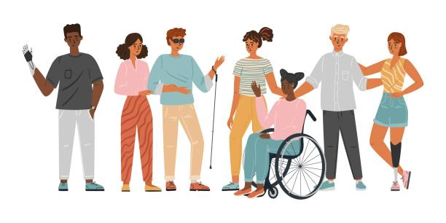
Inclusivity
I also use images that reflect diversity and inclusivity

Slide 22
Inclusivity
Using preferred pronouns is another way of fostering inclusivity, of creating a safe space and of normalizing alternative identities.

Slide 23
Inclusivity
Using gender neutral language:
I don’t use… | I use…
Mailman | Mail carrier
Fireman | Fire fighter
Handyman | Handy person
Delivery man | Delivery person
Manning a table/booth | Minding a table/booth

Slide 24
Inclusivity & Accessibility
Keeping co$ts down for class materials, including readings/textbooks or course packs.

Slide 27
Safety
Ensuring everyone feels safe in the classroom
In terms of asking questions (no question is too dumb, reminders that we are learning together, and to not be afraid to participate or pose questions)

Slide 28
Safety
Ensuring everyone feels safe in the classroom
In terms of asking questions (no questions is too dumb, reminders that we are learning together, and to not be afraid to participate or pose questions)
Letting students know that I value their contributions and their feedback, and that I take in into account in planning future courses.

Slide 30
Areas in Which to Exercise Flexibility
Pedagogical Methods (Presentation of Material)
Availability of Materials
Varied Material
Means of Communication w/ Prof.
Deadlines

Slide 31
UDL by Design
Course Outlines
Presentation of Material
In the Classroom
Outside of Class Time
Activity Design

Slide 33
Course Outline : Changes!
Adding visuals
Making outline more airy
Inserting language that shows inclusivity & universal design principles

Slide 34
Course Outline : Before & After!

Slide 35
Course Outline : Before & After!

Slide 36
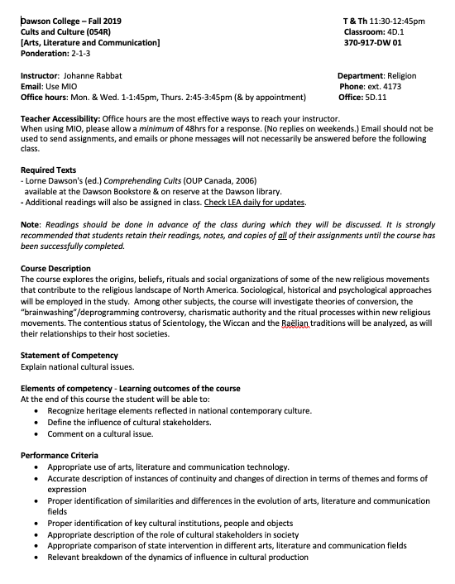

Slide 37
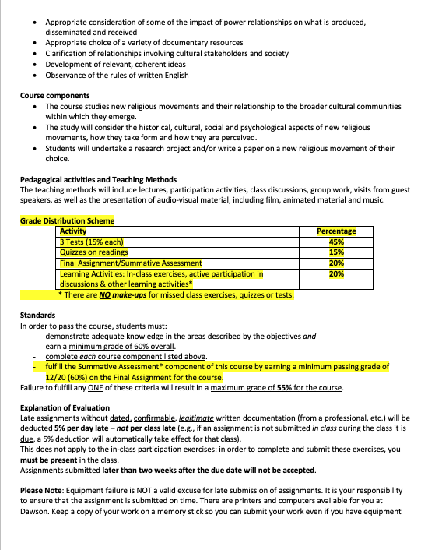

Slide 38
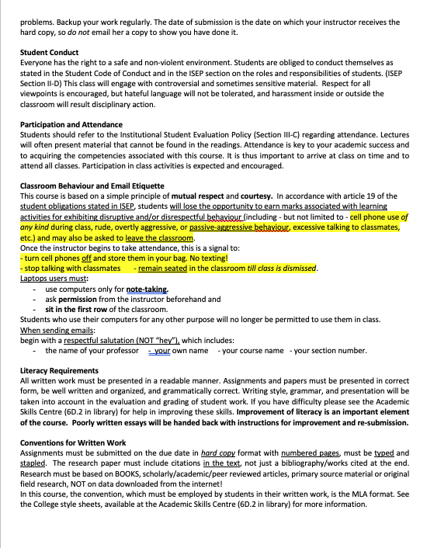
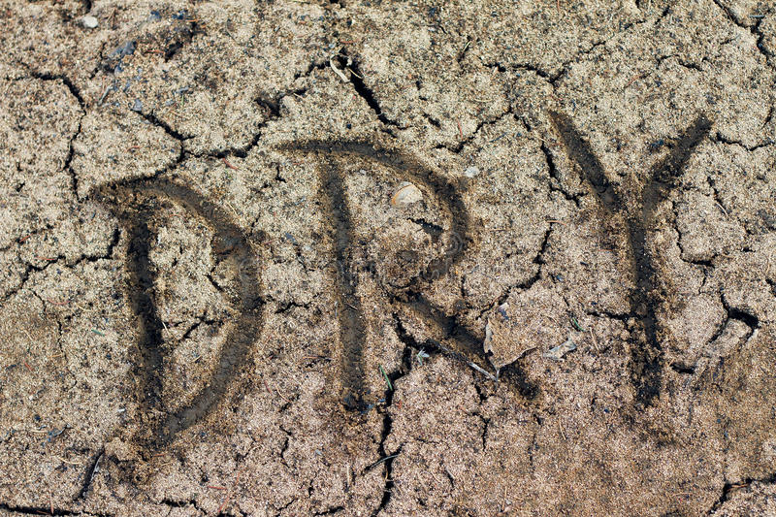

Slide 40
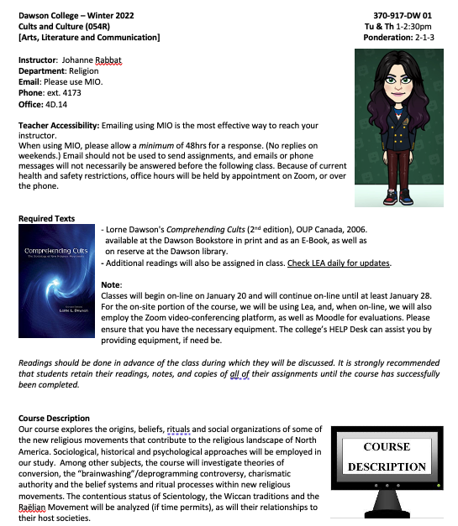

Slide 41
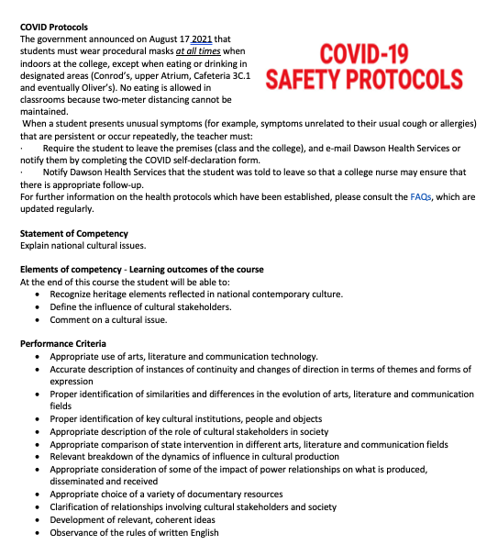

Slide 42
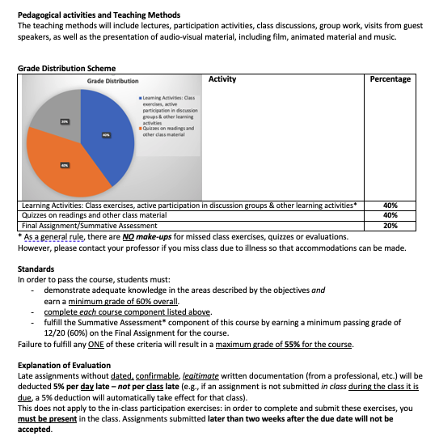

Slide 43
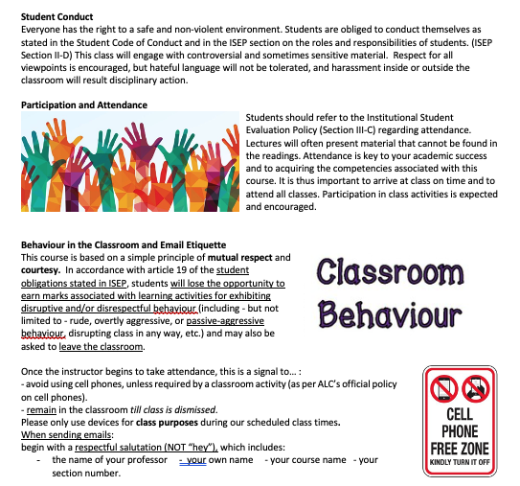

Slide 46
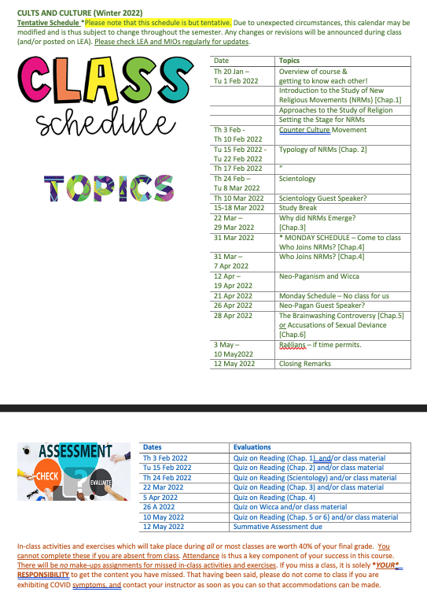

Slide 47
Learning Activities
Informing students as to the goal of particular activities
Making explicit links between the topics covered

Slide 48
More ways I have incorporated UDL into my courses
Large font size on slides, fonts w/ no serifs, limiting words per slide, slowly revealing information by using animation function.
Defining terms (not taking for granted students already know them).
Modeling / providing different examples.
Providing access to material covered in class.

Slide 49
More ways I have incorporated UDL into my courses
Using a variety of different images to represent a concept.
Contact w/ instructor via phone, email, or in person.
Providing study guides to evaluations and informing students of the format of my evaluations.
Posting the instructions to my in-class tests before the test takes place so that studenst know what to expect.

Slide 50
Importance of Affect in Learning

Slide 51
Importance of Affect in Creating Meaningful Relationships &…

Slide 52
Acknowledging Affect to Create

Slide 53
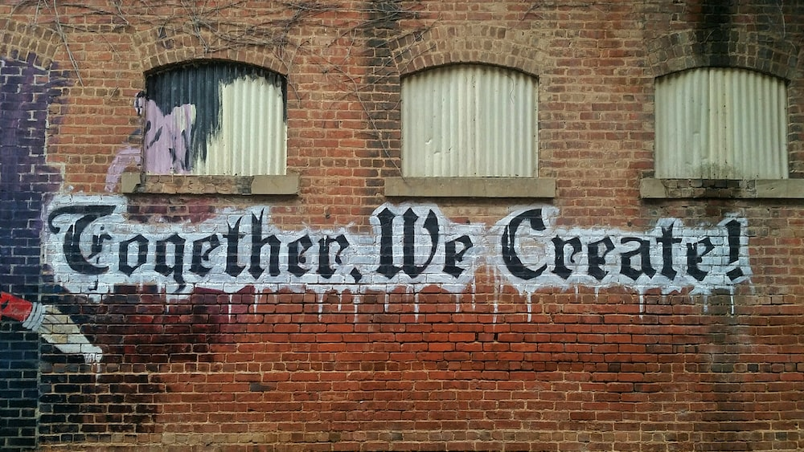
Learning as a Creative Endeavour

Slide 54
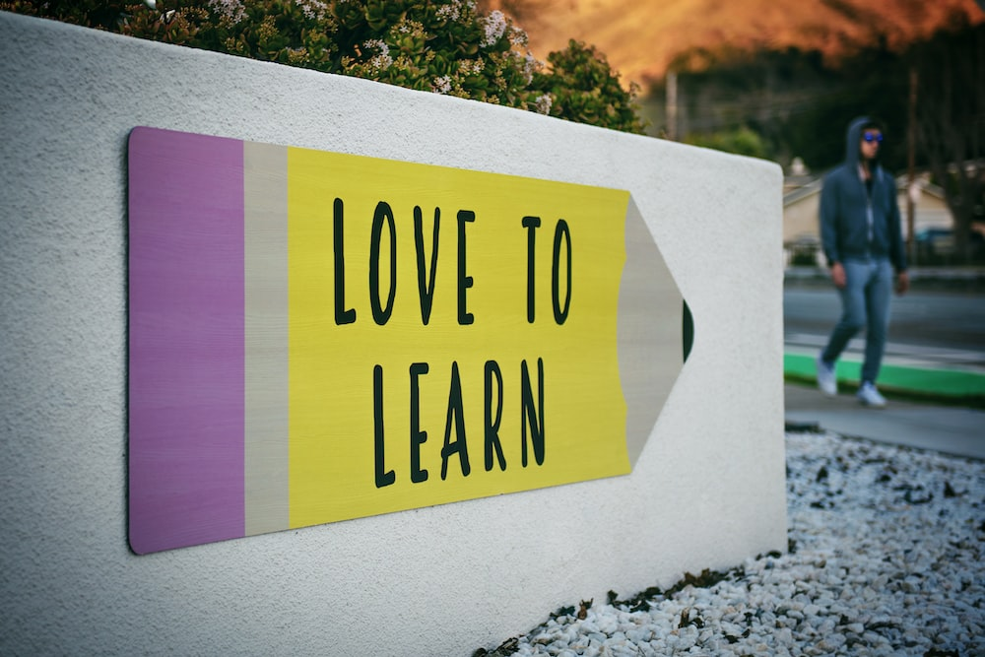
Acknowledging Affect to Create
Inspire students to

Slide 55
In sum: My Keys to UDL Implementation
Accessibility
Inclusivity
Safety
Flexibility
Affect
Safety
Accessibility
Affect
Flexibility
Inclusivity

Slide 56
In Sum: My Keys to UDL Implementation
Safety
Accessibility
Affect
Flexibility
Inclusivity
S.A.A.F.I.

Slide 57
More work yet to be done…
Since learning is as on-going for an instructor as it is for a student, I know that there are still areas in need of improvement with respect to:
Evaluations that adequately measure learning b/c they do not exclude students who may not fit the mold of the conventional ‘exam-writing student’;
Effective delivery methods that will not spoon feed students but rather supplement their learning and provide them with the time and formats they need to best learn.

Slide 58
More work yet to be done…
Since learning is as on-going for an instructor as it is for a student, I know that there are still areas in need of improvement with respect to:
Also: Providing descriptions in my presentations for my images for the visually impaired

Slide 60
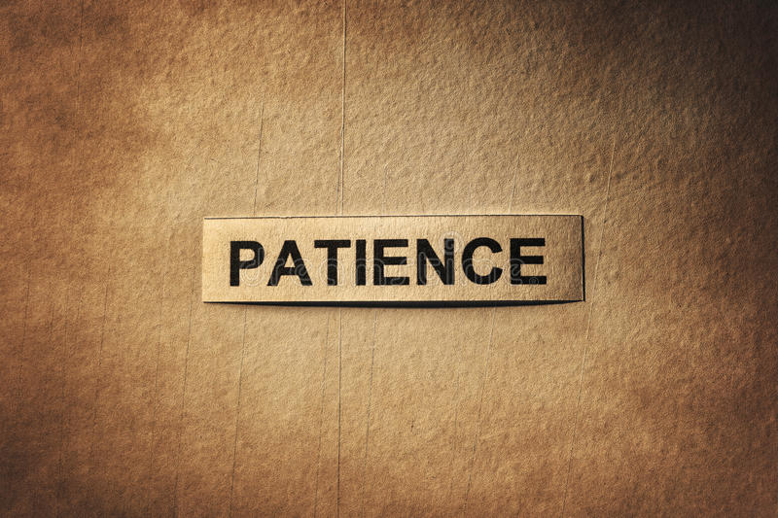

Slide 61
Turning to Our UDL Colleagues for Resources
Asking our mentors Laure and Catherine
Listening to our fellow fellows: Mariam and Caroline
Using the UDL site to see what our colleagues have done.

Slide 62
Turning to Our UDL Colleagues for Resources
A sincere
thank you
to you all!

