Slide 1
Universal Design for Learning in Physical Education
BY: JEFFREY ZEIDEL

Slide 2
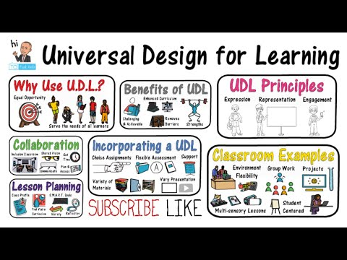
What is Universal Design for Learning?
"Universal design for learning (UDL) is a framework to improve and optimize teaching and learning for all people based on scientific insights into how humans learn" (CAST).
https://www.youtube.com/watch?v=gmGgplQkrVw

Slide 3
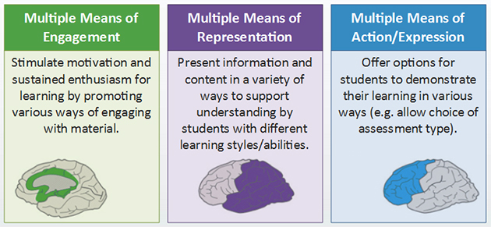
What are the guidelines of UDL?

Slide 4
Part 1: What led me to UDL?
As a student, I struggled within certain subjects to understand the key components and principles. I had to develop my own strategies that would enable me to overcome my barries. I learnt quickly when entering the field of education that students learn at different paces and learn in multiple ways. When reflecting on my methods of pedagogy I discovered that I was teaching students to my liking rather than teaching to theirs. It was only until my final year of my graduate degree that I discovered UDL through a peer presentation.
Since learning the basics of UDL I have been trying to implement strategies to help ease student success.

Slide 5
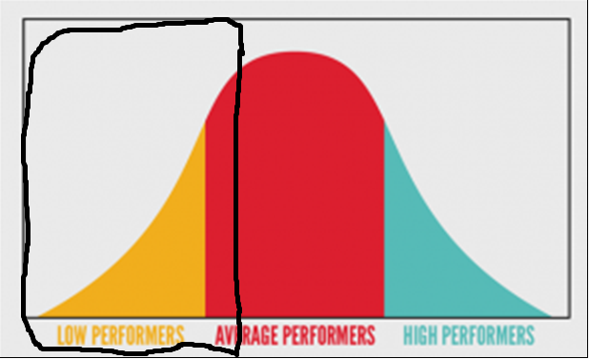
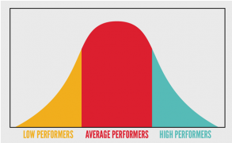
The Problem:
Source: https://www.jantakhoj.com/blog/bell-curved-performance-appraisals-good-bad/

Slide 6
Obstacles within Physical Education
Student presence and participation
Non- typical classroom
Wide level of student experience/knowledge of course material/subject
Student backgrounds
Mobility issues
Medical issues
Limited time (30hrs over 15 weeks)
Types of learners
Assessment tools

Slide 7
Original Plan:
Implementation of a full semester scaffolding project which would have included:
  Fitness and lifestyle assessment
  Dietary analysis
  Healthy meal presentation
  End of semester reflection
Modified Plan
Implementation of UDL tools and strategies into existing courses.
  Tools and strategies to be seen in upcoming slides

Slide 8
Part 2: Implementing Strategies and Techniques

Slide 9
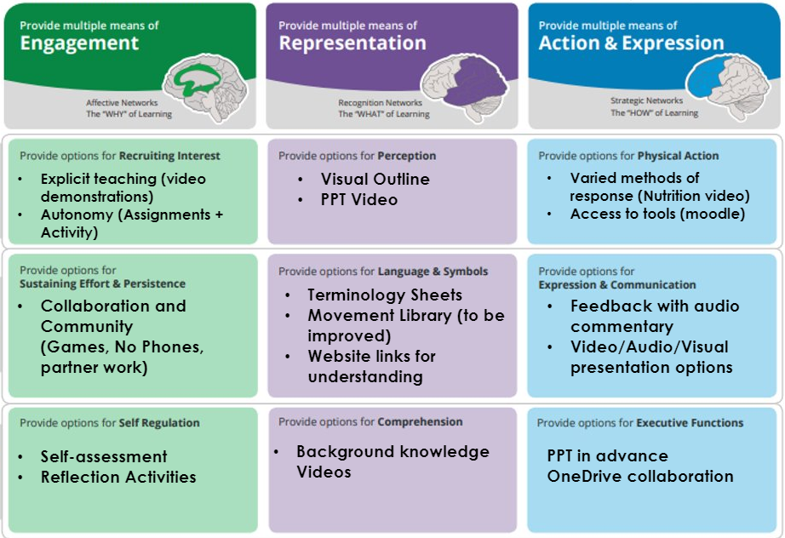
Guiding Guidelines

Slide 10
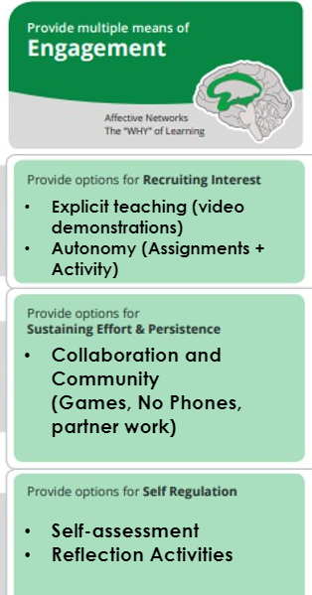
Engagement
Providing options for recruiting interest:
  Through the use of various applications and media platforms students were provided meaningful ways of drawing attention interests towards class activities and assignments.
    Ex: Physical Education Instagram Page
    Ex: Individualized Moodle class pages for each course
  Student autonomy was also seen as a critical means of recruiting interest. There was no point in forcing students into performing generalized assignments. Class assignments were adapted to be unique to each students interest of the course.
    Ex: Individualized program plans

Slide 11
Engagement
Options for sustaining effort and persistence:
  Participation grades hold important value to every physical education class and the importance to have students engaged to maximize success is critical. Creating a warm and safe environment was a means in achieving this goal.
    Ex: No phone policy → Increase student to student interactions
    Ex: Partner and group work in a controlled environment
    Ex: Low organized games that are silly and fun to bring out inner emotions
  Such activities allowed groups to create a sense of community within the classroom.

Slide 12
Engagement
Options for self-regulation:
  Dawson is the largest English Cegep in Quebec, welcoming roughly 11,000 students. That is a 11,000 unique individuals that come from 11,000 unique backgrounds with each requiring a means of self-regulation.
  At the end of each class students are offered a variety of tools to self-regulate:
    Ex: Individualized active response sheets
    Ex: Meditation, stretching, yoga or active cooldown
    Ex: Personal feedback
  These tools may not meet each students need however the use of these tools such as weekly reflections appear to provide a gateway for students to regulate certain thoughts and feelings.

Slide 13
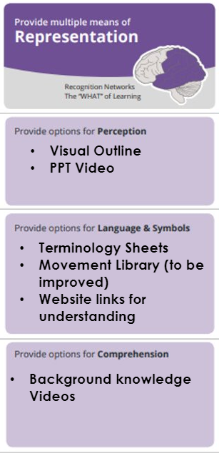
Representation
Through the use of the UDL approach providing multiple means of representation is critical to students comprehension.
Tools provided for perception:
  Simplified course outlines highlighting critical components of the course : Course Outline Example
  Weekly PowerPoints notes to culminate course package
    Example #1
    Example #2
PowerPoints were uploaded prior to each class to allow students become familiar with weekly lessons to help encourage understanding and class participation.

Slide 14
Representation
Similar to every discipline, Physical Education and Health industry uses a wide-range of language and symbols. The lingo can become complicated and will leave students playing catchup if not learnt. Through the use of cheat sheets and study guides, Students are provided with the tools to feel competent and comfortable within class.
Examples of some documents used in class:
  Weight Training Terminology
  Progressions
  Movement Library

Slide 15
Representation
My long-term goal for UDL is provide students with a flipped classroom. In the meantime, I have spent a majority of my time in providing students with recordings on key concepts and projects from class.
  This provides students who are absent to access missed content
  Provides students another “representation” or “viewpoint” to the topic at hand.
  Unlimited playbacks
Examples:
    Example 1
    Example 2

Slide 16
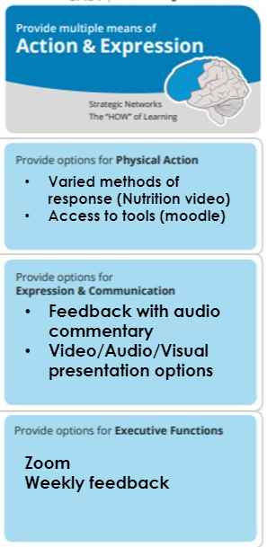
Action and Expression
One of my main objectives of UDL was to provide multiple means of expression and actions for my students. There isn't one blueprint for all, students have their own unique strengths and weaknesses and should be able to choose their own path to the finish line.
Physical Action:
  Assignments, students were provided with less structured assignments to encourage creativity.
    Example 1
    Example 2
    Example 3

Slide 17
Action and Expression
I was never great when it came to linguistics, I always felt that assignments were often bias towards one's ability to articulate in the written word. This semester I provided students the option to express their work in various means. Most students kept to the traditional means of expressing their work however, I did have several students decide to present their work orally or visually.
Results: Students from all various disciplines producing unique assignments through countless avenues:
  Mindmaps
  Prezi
  Video projects
  PowerPoint

Slide 18
Action and Expression
Providing options for executive functions:
With the winter 2020 semester moving to online I did my best to support students in various means for executive functions:
  Webinars (zoom)
  How to videos (youtube & moodle)
  Weekly planning sessions for students (individual and collaboratively)
  Weekly feedback related to goals

Slide 19
Outcome of a UDL approach
A Universal Design for Learning approach has had
  Safer and more welcoming environment
  Understanding of course competency and elements
  Better understanding of course material and assignments
  Improved grades
  Improved accessibility digitally
  Decrease in student stress
    Data was collected through quick surveys, class discussion and 1 on1 conversations

Slide 20
What is next?
My UDL journey is not yet over. I plan to focus my attention on improving my course assignments and activities. My long-term goal is to provide:
Flipped classrooms with pre-recorded class lectures
More "how to" videos explaining assignments and course materials
Continue to build my Moodle pages
Implementing more diverse and inclusive activities into class

Slide 21
Part 3: My learning Experience and Emotions

Slide 22
My learning Experience
Implementing a UDL approach was a much bigger task than I originally thought. Through the experience I found myself immersing myself deeper within the College and extending my network to other departments and committees.
Not only has the UDL approach helped my students, it has also led me to develop and improve my professional skills, such as:
  Adobe professional
  Wacom (tablet use)
  Moodle
  Film recording and editing

Slide 23
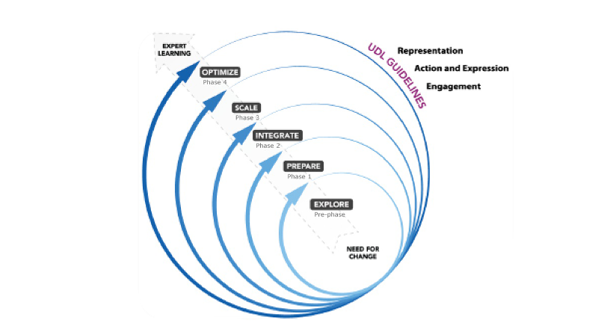
My learning Experience (cont)
The following diagram illustrates the CAST UDL implementation process into schools & school boards.
Source: http://www.cast.org/products-services/consultation-curriculum-design

Slide 24
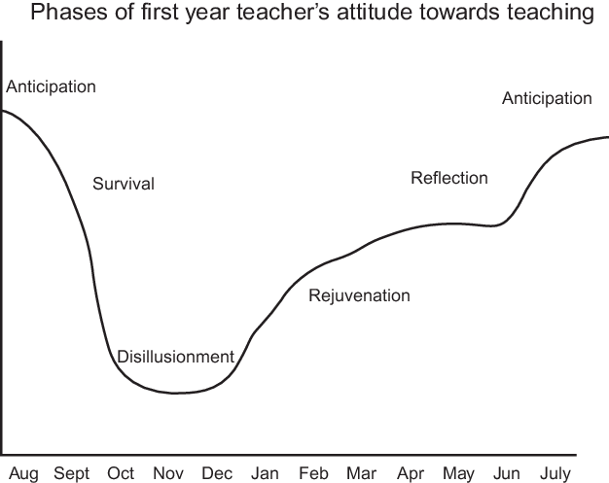
My learning Experience (cont)
Switching to a UDL left me feeling like a first year teacher again.
Source: Moir, E. (1990). Phases of first-year teaching

Slide 25
Feedback to future UDLers
Don’t be afraid to try new things
Take all the advice you can get
At first if it doesn’t work, don’t give up.
Trust the process!

Slide 26
References:
Consultation & Curriculum Design (n.d). Retrieved from http://www.cast.org/products-services/consultation-curriculum-design
Meyer, A., Rose, D. H., & Gordon, D. T. (2014). Universal design for learning: Theory and practice.
Moir, E. (1990). Phases of first-year teaching. California New teacher Project Newsletter. Sacramento, CA: California Department of Education.
Novak, K. (2016). Udl now!: A teacher's guide to applying universal design for learning in today's classrooms. Place of publication not identified: Cast Professional Pub.

