Slide 1
My UDL Journey through the Emergency Distance Teaching
Logo for the Dawson UDL Community shown
(UDL stands for Universal Design for Learning)
By
Yoon-Seo Uh
a Chemistry faculty and 2020 UDL Fellow

Slide 2
Impact of Distance Learning on Students’ Learning
- *Data from the student survey conducted by Quality Assurance & Planning Office in Fall 2020 (click link)
[Number of responses (N) = 4362 out of 10,834 eligible participants]
Level of student’s satisfaction with emergency distance learning, | 3.3 (New students)
 | 3.0 (returning students)
Level of which they feel connected to the other students in online courses, | 2.5 (New students)
 | 2.3 (returning students)
Level of which they feel connected to their teachers in online courses, | 3.0 (New students)
 | 2.8 (returning students)
Level of how much the students feel engaged in learning, | 3.5 (New students)
 | 3.1 (returning students)
Other notable feedbacks by the students were,
too much or too little synchronous classes
wanting more interaction with other students
looking for simplified ways to extract course information including assignments and assessments
asking for teachers to be empathetic and understanding

Slide 3
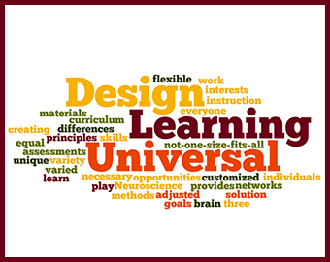
What and Why Universal Design For Learning?
Universal Design for Learning is,
aiming to create an inclusive and safe learning environment that focuses on learner variability and decreasing barriers,
a set of framework to design, implement and evaluate accessible learning and teaching experiences,
and this accessibility is achieved by providing alternate representations, expressions and engagement.
Shown above is an image of keywords that characterize the UDL
UDL
Representation
the WHAT of learning,
Provide various ways of acquiring information and knowledge
Action & Expression
the HOW of learning,
Vary the ways students express what they know
Engagement
the WHY of learning,
Activate learner’s interest, offer appropriate challenges and increase motivation
udlguidelines.cast.org for more information

Slide 4
What and Why Universal Design For Learning?
UDL
Representation
Technology (or technology-less options)
Action & Expression
Instructor
+
Students
Active Learning
Engagement
Challenges & Opportunities
Managing a group of 20 students in term 2 of the Chemistry Laboratory Technology Program; a wide variation in age, previous academic experiences and access to technology
Limited access to laboratory space; organize and digitize laboratory activities that are not deemed “critically essential” to the attainment of competencies
Impact of pandemic on students’ learning; help students manage workload, time and stress

Slide 5
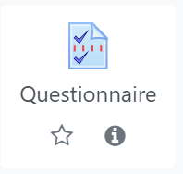
UDL
Organization of Learning Management System
Representation
Action & Expression
Engagement
Acknowledgement to the students of my commitment to UDL
Simplified access to frequently used resources
Two time slots at which every student in the course is available.
Decided by the students.

Slide 6
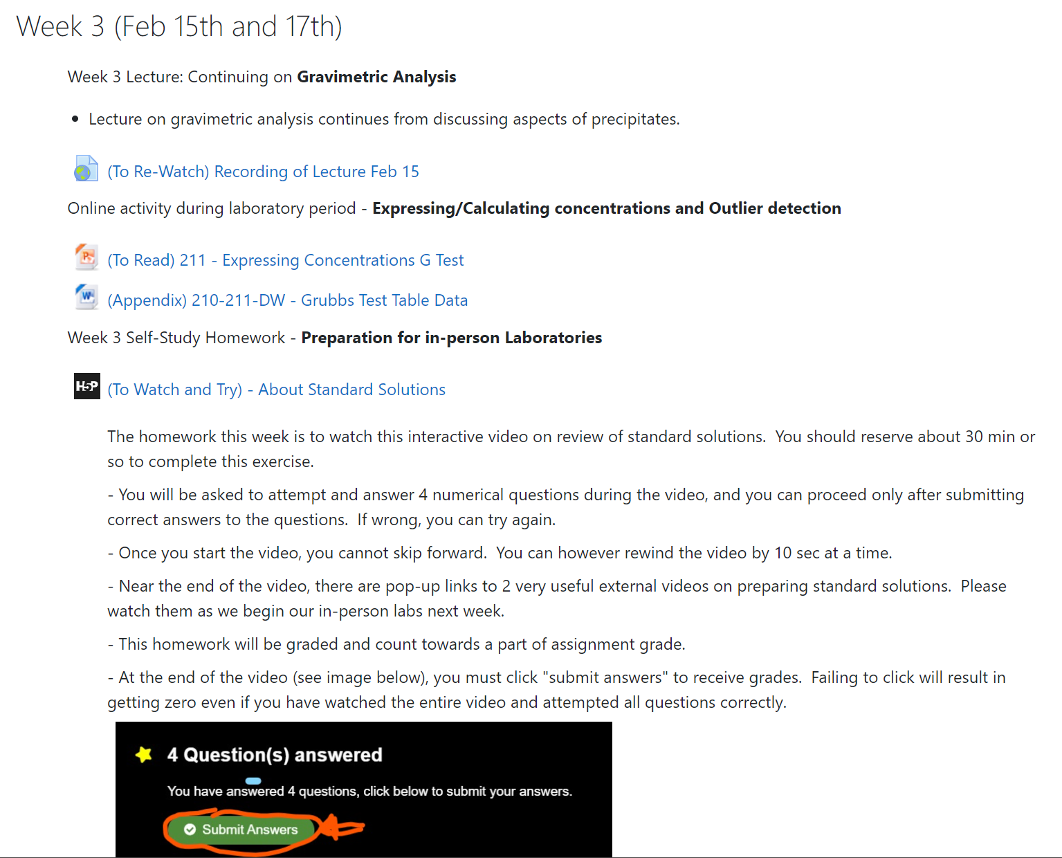
UDL
Organization of Learning Management System
Representation
Consistent weekly format consisting of 3 categories:
Lecture video / Course Materials / Homework
Action & Expression
Information updated on Friday of each week
Engagement
Start with stating weekly learning objectives
Link to recorded lectures with caption
For students who prefer asynchronous learning
Course materials needed for the week
Instructions for Homework
Low stakes assignments
Unlimited time / attempts
*Students on average repeat homework 2 to 3 times.

Slide 7
UDL
Explicit Instruction in designing class activities
Representation
Explicit instruction in UDL is teaching a specific (or complex) skill or concept by breaking it into a series of smaller parts.
Action & Expression
For each part, coupled with a guided activity, instructor highlights important details of the concept or skill to support students with learning.
Engagement
Students have opportunities to engage in guided, independent or collaborative practice, and receive timely feedback from the instructor

Slide 8
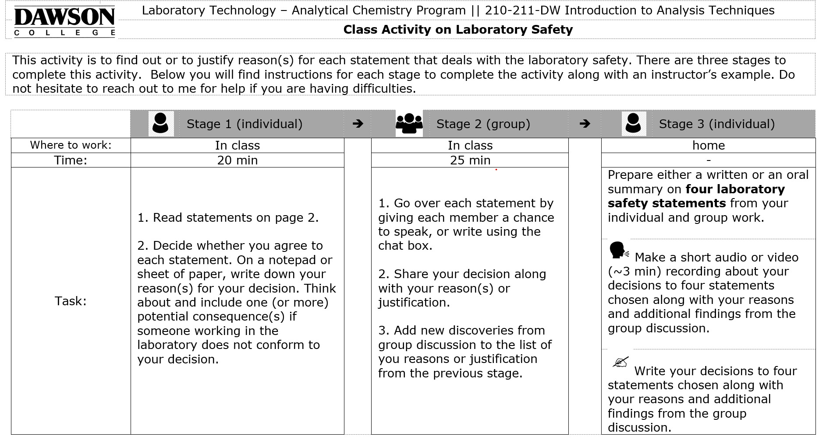
UDL
Explicit Instruction in designing class activities
Representation
Explicit instruction in UDL is teaching a specific (or complex) skill or concept by breaking it into a series of smaller parts.
Action & Expression
For each part, coupled with a guided activity, instructor highlights important details of the concept or skill to support students with learning.
Engagement
Students have opportunities to engage in guided, independent or collaborative practice, and receive timely feedback from the instructor
State learning objectives
Instructions for each stage of the activity
Click to see a full example

Slide 9
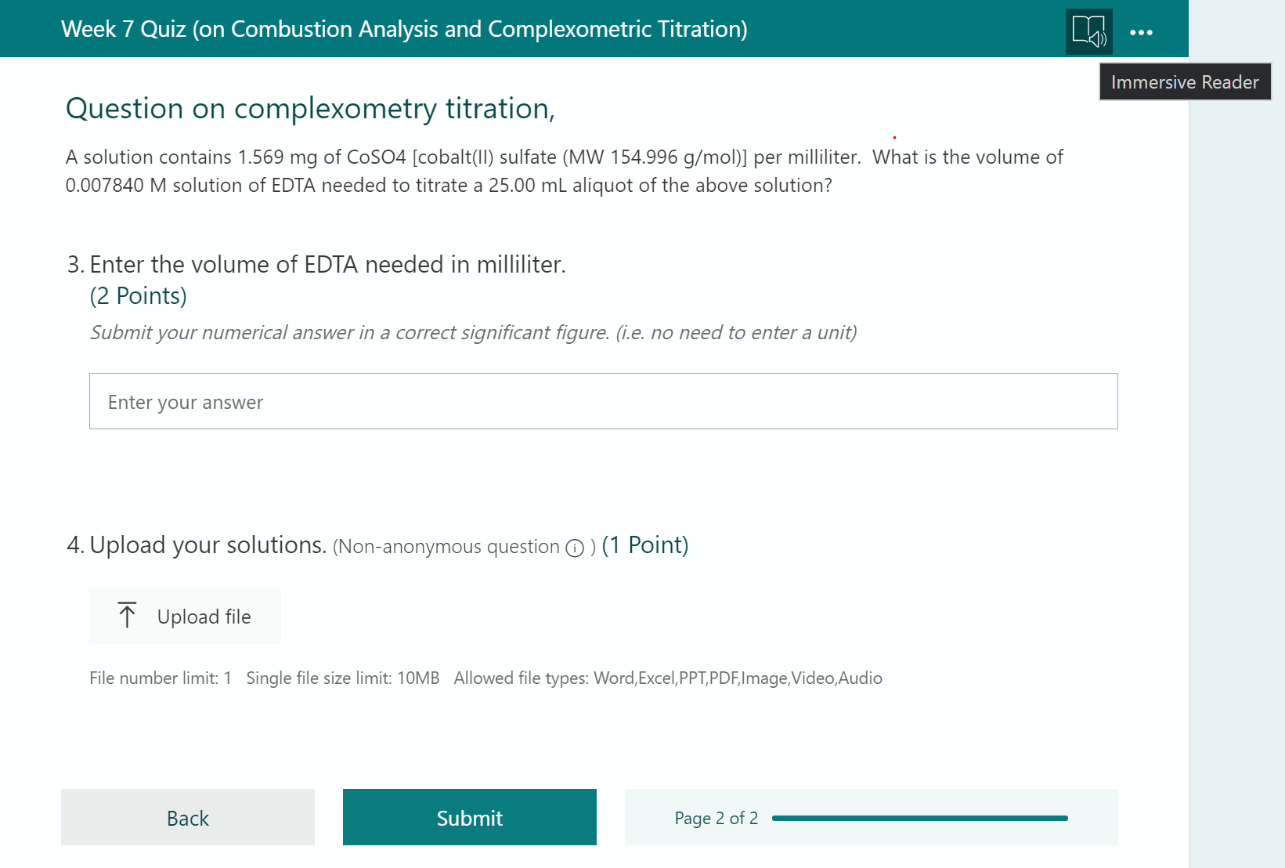
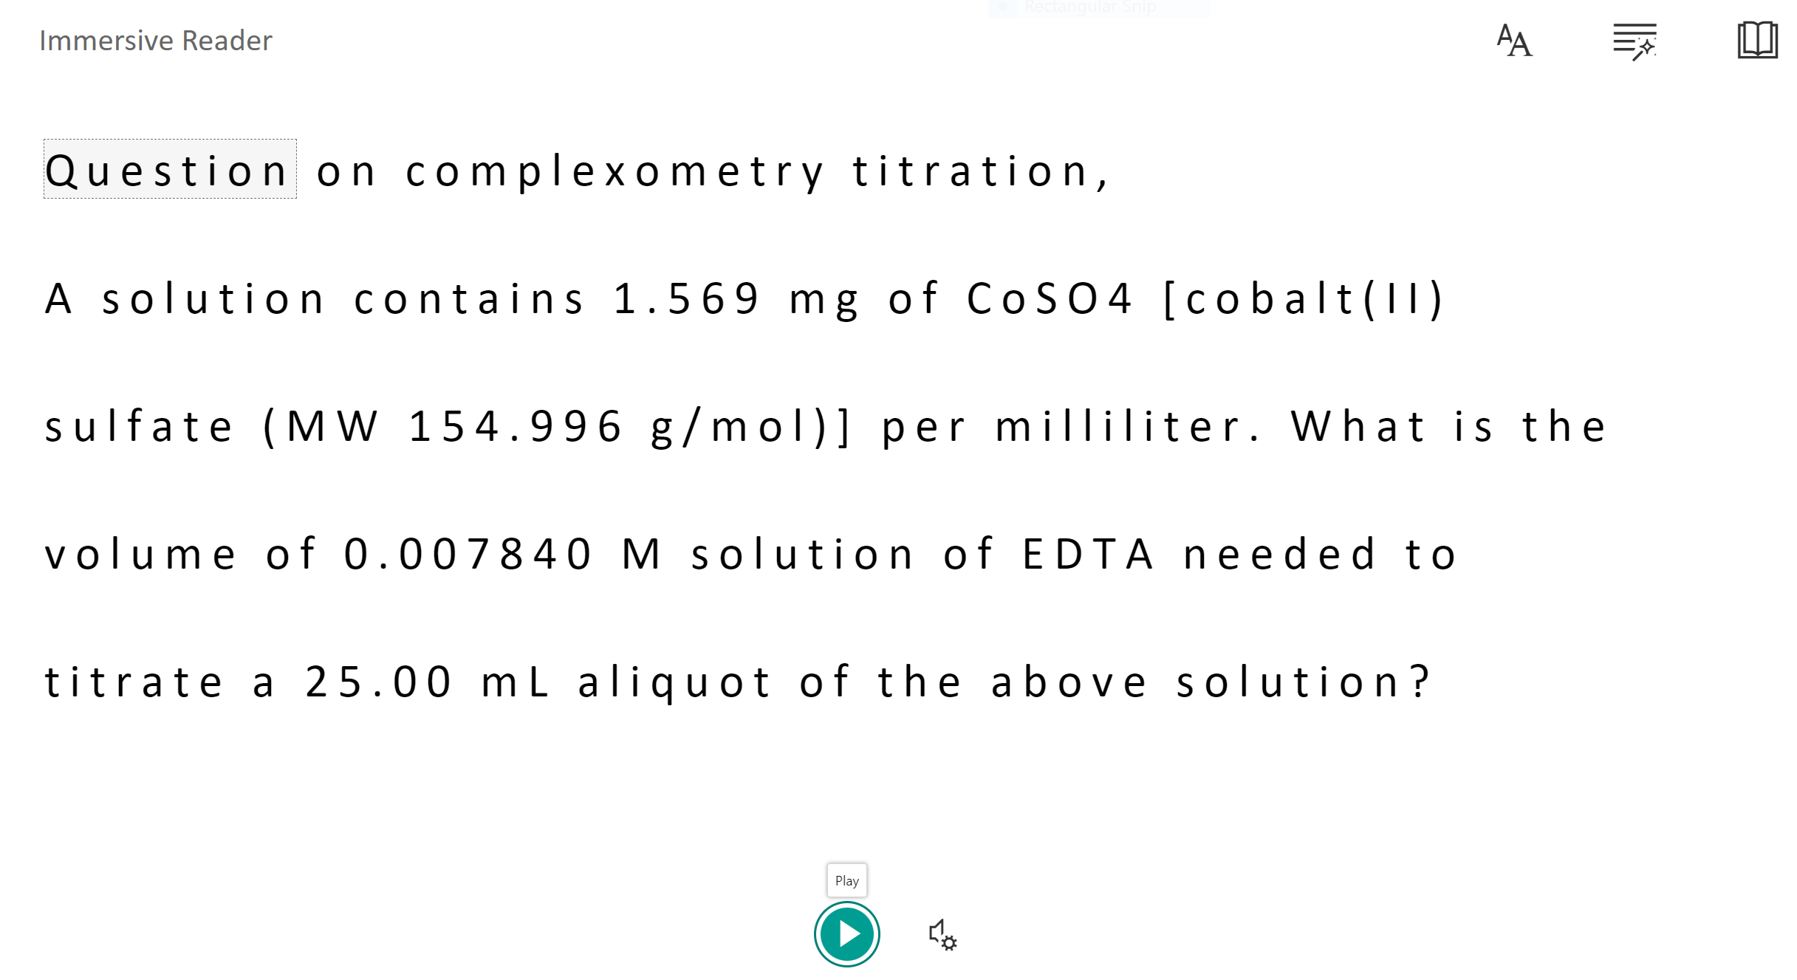
UDL
Options for Assessment
Representation
Open book assignments/assessments were encouraged.
Action & Expression
MS Forms provided flexible options for students to complete and submit their work and to receive instant feedback.
Easy integration into LMS such as Moodle
Engagement
Assessments can be completed online or offline. (ex. questions can be printed on paper) by students
Upload supports multiple file formats (picture, video and audio)
Students can express (and share instantly) their difficulties about an assessment in the format of their preferences.
For students with visual impairment, activating “immersive reader” reads out questions.
Progress tracker

Slide 10
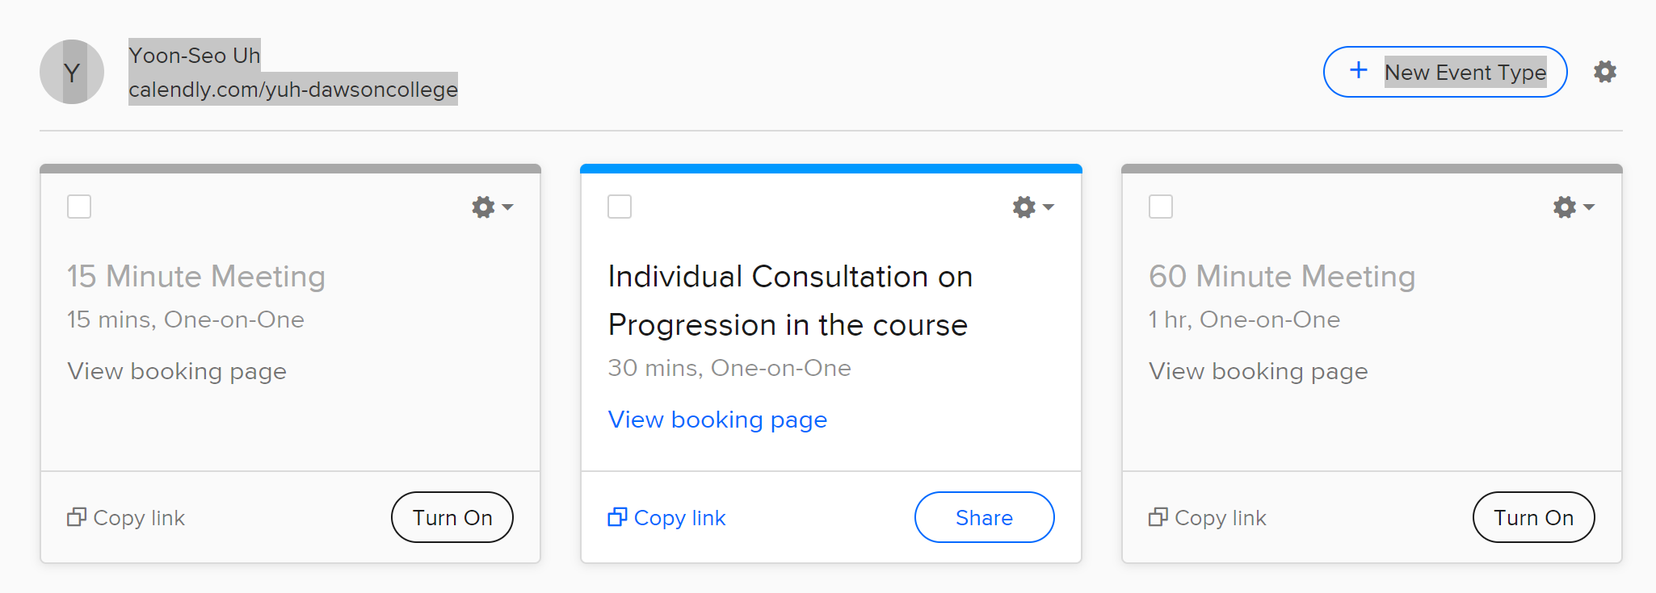
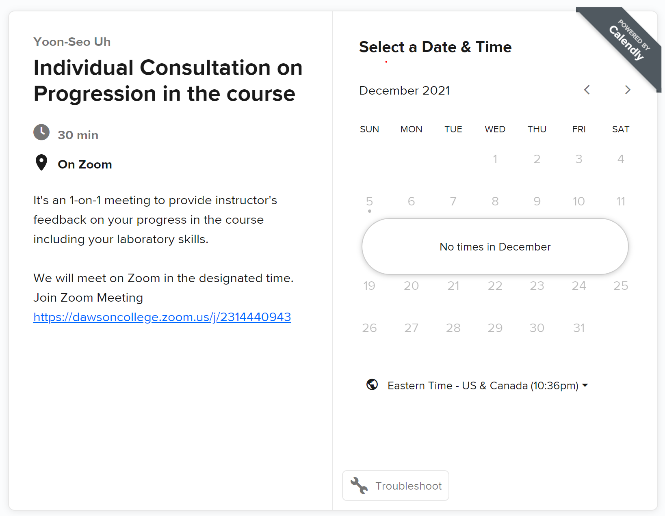
UDL
Options for Engagement
Representation
Flexibility for students to get in touch online whenever needed,
Action & Expression
Calendly (calendly.com) is a free, easy to use scheduling application to set up either one-on-one or group meetings.
Instructor set up availabilities visible to students in advance,
Engagement
and students sign up for allocated 15 min, 30 min or 1h time slots.
Used it for 1-on-1 Mid-term Assessment.
Students can browse the calendar and view and book the instructor’s availability in advance
You can embed and send the information about how long and where the meeting is taking place.
Click to see a full example

Slide 11
Acknowledgement
I would like to express my deepest appreciation to,
Dawson College
Student AccessAbility Centre (SAAC)
2020 UDL Team – Alexandra Law (Humanity)
(Amazing)
Kathryn Hall (English)
Mari Heywood (Humanities)
& Catherine Soleil and Laure Galipeau

